Slide 1
The Platform Inside and Out
Release 0.15
Joshua Patterson – Senior Director, RAPIDS Engineering
Notes:
https://rapids.ai/ https://github.com/rapidsai
https://docs.rapids.ai/overview

Slide 2
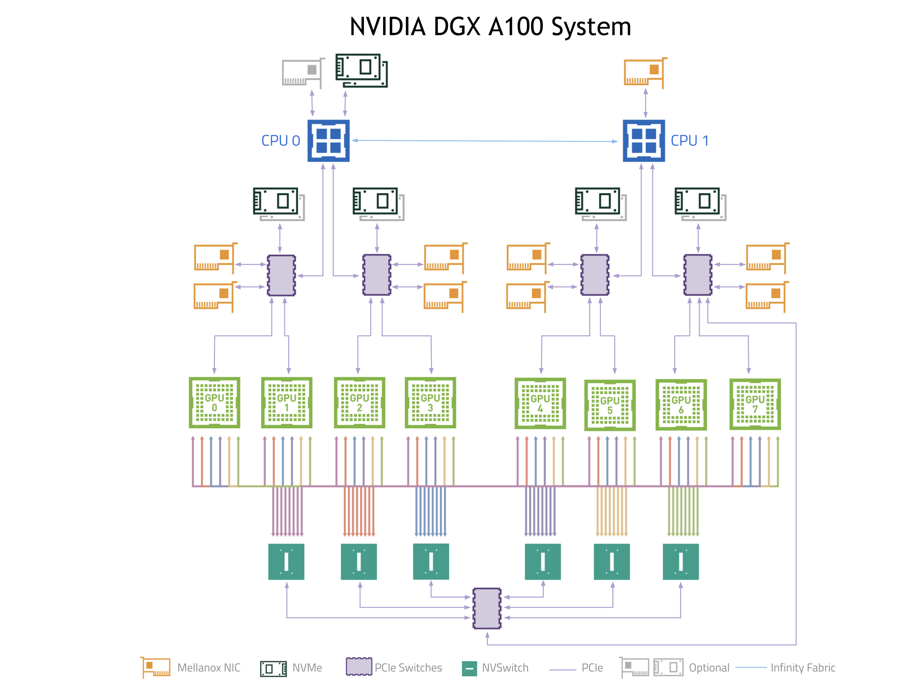
Why GPUs?
Numerous hardware advantages
Thousands of cores with up to ~20 TeraFlops of general purpose compute performance
Up to 1.5 TB/s of memory bandwidth
Hardware interconnects for up to 600 GB/s bidirectional GPU <--> GPU bandwidth
Can scale up to 16x GPUs in a single node
Almost never run out of compute relative to memory bandwidth!

Slide 3

RAPIDS
End-to-End GPU Accelerated Data Science
Data Preparation
Model Training
Visualization
Dask
cuDF cuIO
Analytics
cuML
Machine Learning
cuGraph
Graph Analytics
PyTorch, TensorFlow, MxNet
Deep Learning
cuxfilter, pyViz, plotly
Visualization
GPU Memory

Slide 4
Data Processing Evolution
Faster Data Access, Less Data Movement
Hadoop Processing, Reading from Disk
HDFS Read
Query
HDFS Write
HDFS Read
ETL
HDFS Write
HDFS Read
ML Train
25-100x Improvement
Less Code
Language Flexible
Primarily In-Memory
Spark In-Memory Processing
HDFS Read
Query
ETL
ML Train
Traditional GPU Processing
5-10x Improvement
More Code
Language Rigid
Substantially on GPU
HDFS Read
GPU
Read
Query
CPU
Write
GPU
Read
ETL
CPU
Write
GPU
Read
ML
Train

Slide 5
Data Movement and Transformation
The Bane of Productivity and Performance
APP B
Read Data
APP B
GPU DATA
APP B
Copy & Convert
CPU
Copy & Convert
GPU
APP A
Copy & Convert
GPU DATA
APP A
APP A
Load Data

Slide 6
Data Movement and Transformation
What if We Could Keep Data on the GPU?
APP B
Read Data
APP B
GPU DATA
APP B
X
Copy & Convert
CPU
X
GPU
Copy & Convert
APP A
Copy & Convert
X
GPU DATA
APP A
APP A
Load Data

Slide 7

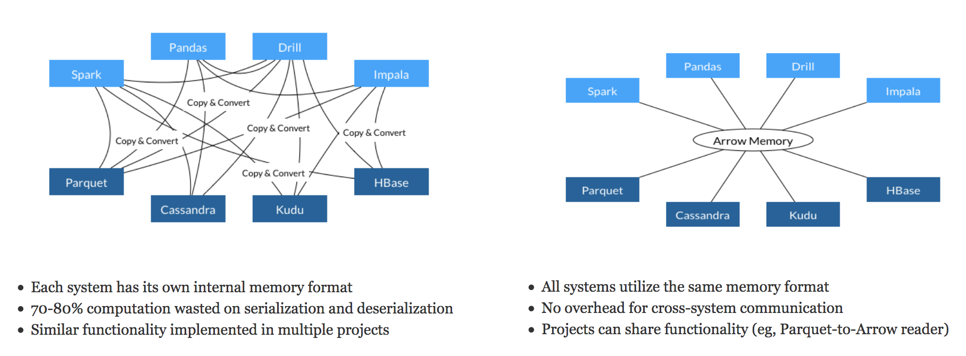
Learning from Apache Arrow
Each system has its own internal memory format
70-80% computation wasted on serialization and deserialization
Similar functionality implemented in multiple projects
All systems utilize the same memory format
No overhead for cross-system communication
Projects can share functionality (eg, Parquet-to-Arrow reader)
Source: From Apache Arrow Home Page - https://arrow.apache.org/

Slide 8
Data Processing Evolution
Faster Data Access, Less Data Movement
Hadoop Processing, Reading from Disk
HDFS Read
Query
HDFS Write
HDFS Read
ETL
HDFS Write
HDFS Read
ML Train
Spark In-Memory Processing
25-100x Improvement
Less Code
Language Flexible
Primarily In-Memory
HDFS Read
Query
ETL
ML Train
Traditional GPU Processing
5-10x Improvement
More Code
Language Rigid
Substantially on GPU
HDFS Read
GPU
Read
Query
CPU
Write
GPU
Read
ETL
CPU
Write
GPU
Read
ML
Train
RAPIDS
50-100x Improvement
Same Code
Language Flexible
Primarily on GPU
Arrow
Read
Query
ETL
ML
Train

Slide 9
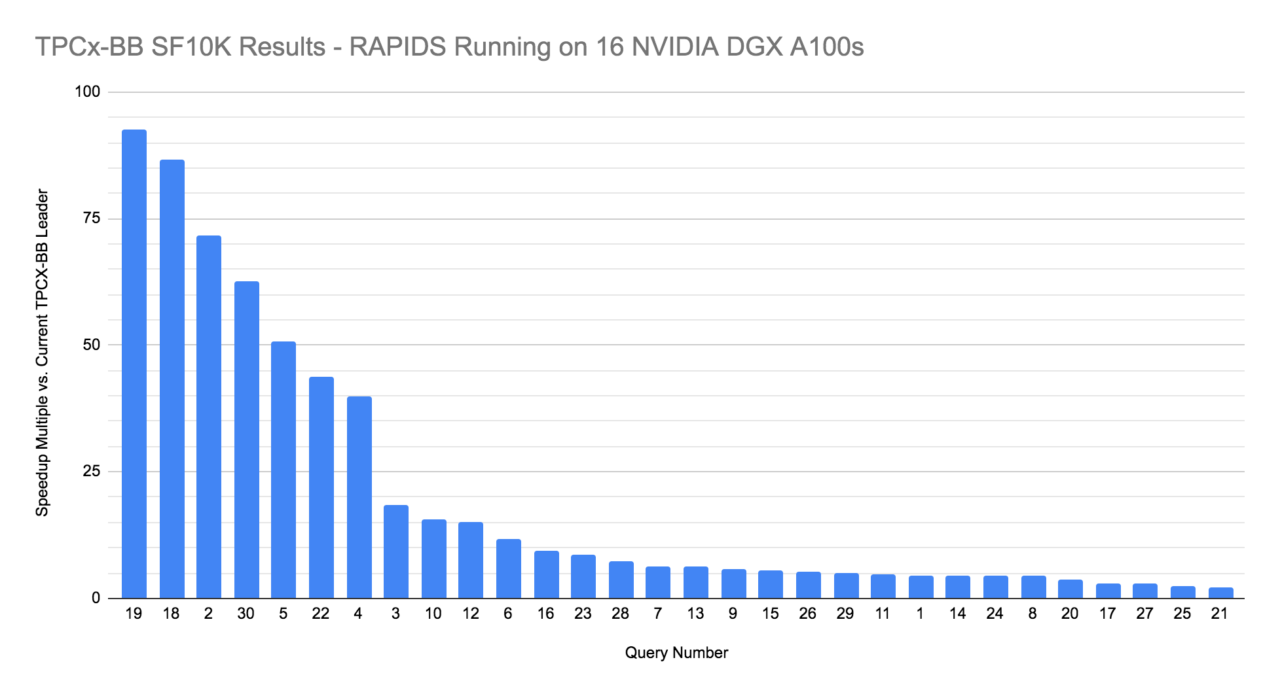
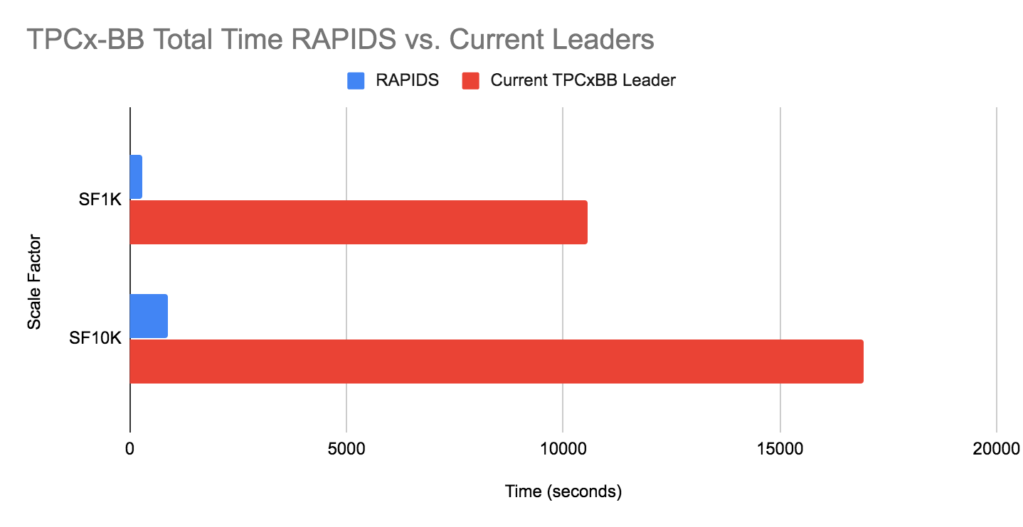





Lightning-fast performance on real-world use cases
Up to 350x faster queries; Hours to Seconds!
TPCx-BB is a data science benchmark consisting of 30 end-to-end queries representing real-world ETL and Machine Learning workflows, involving both structured and unstructured data. It can be run at multiple “Scale Factors”.
SF1 - 1GB
SF1K - 1 TB
SF10K - 10 TB
RAPIDS results at SF1K (2 DGX A100s) and SF10K (16 DGX A100s) show GPUs provide dramatic cost and time-savings for small scale and large-scale data analytics problems
SF1K 37.1x average speed-up
SF10K 19.5x average speed-up (7x Normalized for Cost)

Slide 10
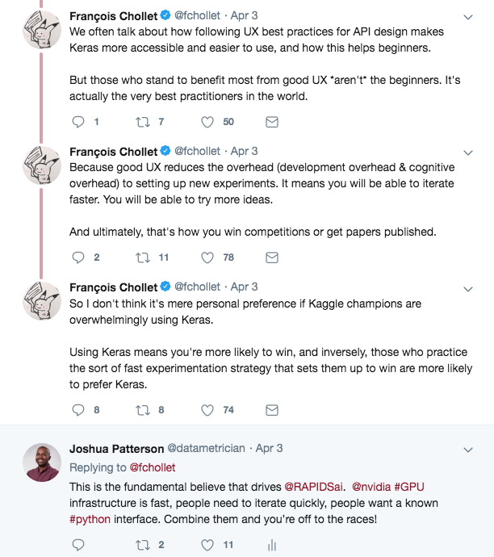
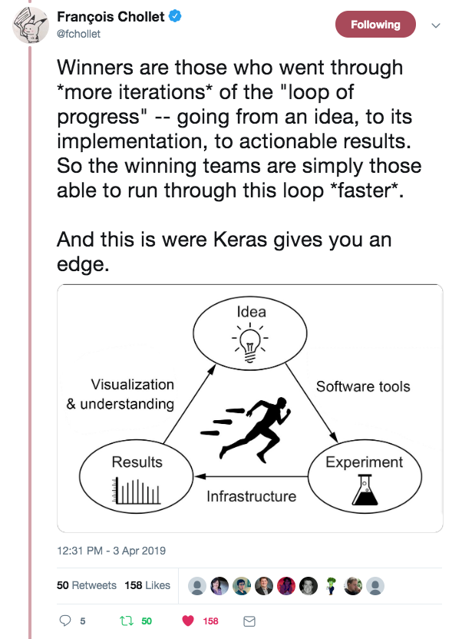
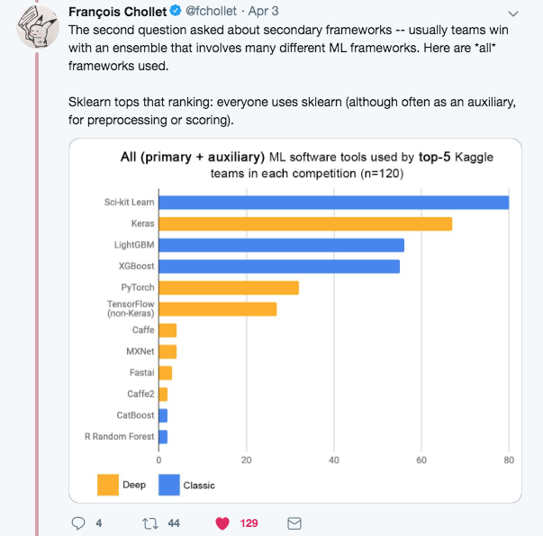

Speed, UX, and Iteration
The Way to Win at Data Science

Slide 11
RAPIDS 0.15 Release Summary

Slide 12
What’s New in Release 0.15?
CUDA 11 and Ampere support added across all libraries.
cuDF adds unsigned integer and timedelta (duration) dtypes support as well as experimental support for a List dtype, Kafka as a supported data source, Groupby.rolling() support, and additional NLP preprocessing functions.
cuML machine learning library adds scikit-learn compatible NLP preprocessors, initial AutoARIMA support, MNMG kNN classification and regression wrappers, accelerated multi-class forest inference, SVM sample weights and probability prediction, and an experimental Incremental PCA model for out-of-core fitting.
cuGraph initial version of the Leiden algorithm, added Edge Betweenness Centrality, improved Louvain and the ECG analytics, and added the HITS algorithm.
UCX-Py adds reusable endpoints, Cython optimizations, code clean up, and bug fixes.
BlazingSQL now supports out-of-core query execution, which enables queries to operate on datasets dramatically larger than available GPU memory.
cuSignal adds multi-point kalman filter, improved embedded GPU support, and performance optimizations.
cuSpatial adds point-to-nearest polyline queries and accelerated point-in-polygon via quadtree.
cuxfilter will have a delayed release, but now has large graph support. See Notice RGN4 in our docs for details.
RMM deprecates the CNMeM, adds per-thread default stream support, adds `binning_memory_resource.

Slide 13
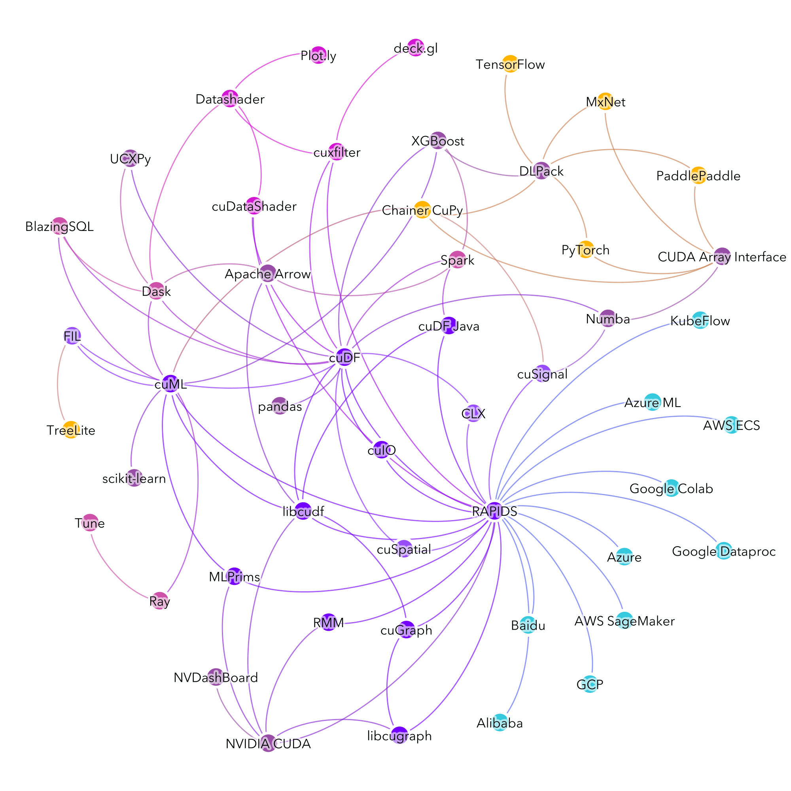
RAPIDS Everywhere
The Next Phase of RAPIDS
Exactly as it sounds—our goal is to make RAPIDS as usable and performant as possible wherever data science is done. We will continue to work with more open source projects to further democratize acceleration and efficiency in data science.

Slide 14
RAPIDS Core

Slide 15
Open Source Data Science Ecosystem
Familiar Python APIs
Data Preparation
Model Training
Visualization
Dask
Pandas
Analytics
Scikit-Learn
Machine Learning
NetworkX
Graph Analytics
PyTorch, TensorFlow, MxNet
Deep Learning
Matplotlib
Visualization
CPU Memory

Slide 16
RAPIDS
End-to-End Accelerated GPU Data Science
Data Preparation
Model Training
Visualization
Dask
cuDF cuIO
Analytics
cuML
Machine Learning
cuGraph
Graph Analytics
PyTorch, TensorFlow, MxNet
Deep Learning
cuxfilter, pyViz, plotly
Visualization
GPU Memory

Slide 17
Dask

Slide 18
RAPIDS
Scaling RAPIDS with Dask
Data Preparation
Model Training
Visualization
Dask
cuDF cuIO
Analytics
cuML
Machine Learning
cuGraph
Graph Analytics
PyTorch, TensorFlow, MxNet
Deep Learning
cuxfilter, pyViz, plotly
Visualization
GPU Memory

Slide 19

Why Dask?
DEPLOYABLE
HPC: SLURM, PBS, LSF, SGE
Cloud: Kubernetes
Hadoop/Spark: Yarn
PYDATA NATIVE
Easy Migration: Built on top of NumPy, Pandas Scikit-Learn, etc
Easy Training: With the same APIs
Trusted: With the same developer community
EASY SCALABILITY
Easy to install and use on a laptop
Scales out to thousand node clusters
POPULAR
Most Common parallelism framework today in the PyData and SciPy community

Slide 20

Why OpenUCX?
Bringing Hardware Accelerated Communications to Dask
TCP sockets are slow!
UCX provides uniform access to transports (TCP, InfiniBand, shared memory, NVLink)
Alpha Python bindings for UCX (ucx-py)
Will provide best communication performance, to Dask based on available hardware on nodes/cluster
conda install -c conda-forge -c rapidsai \
cudatoolkit=<CUDA version> ucx-proc=*=gpu ucx ucx-py

Slide 21
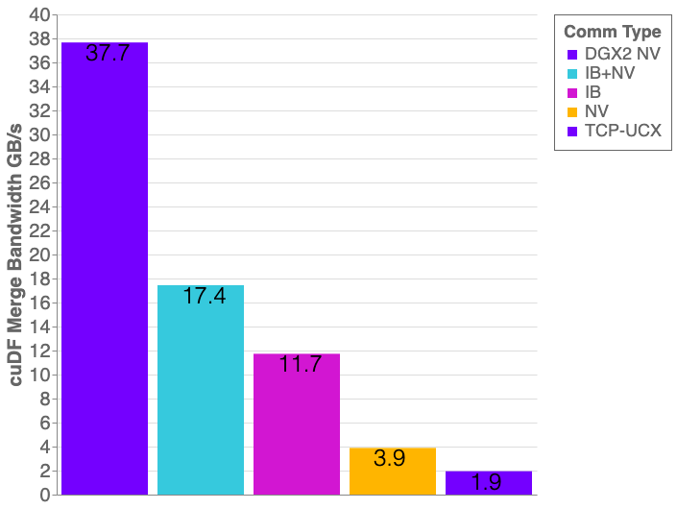
Benchmarks: Distributed cuDF Random Merge
cuDF v0.14, UCX-PY 0.14
Running on NVIDIA DGX-2:
GPU: NVIDIA Tesla V100 32GB
CPU: Intel(R) Xeon(R) CPU 8168 @ 2.70GHz
Benchmark Setup:
DataFrames: Left/Right 1x int64 column key column, 1x int64 value columns
Merge: Inner
30% of matching data balanced across each partition

Slide 22



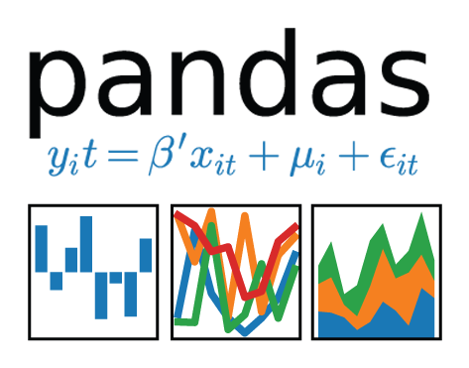


Scale Up with RAPIDS
RAPIDS AND OTHERS
Accelerated on single GPU
NumPy -> CuPy/PyTorch/..
Pandas -> cuDF
Scikit-Learn -> cuML
Numba -> Numba
Scale Up / Accelerate
PYDATA
NumPy, Pandas, Scikit-Learn, Numba and many more
Single CPU core
In-memory data

Slide 23
Scale Out with RAPIDS + Dask with OpenUCX
RAPIDS AND OTHERS
RAPIDS + DASK WITH OPENUCX
Accelerated on single GPU
NumPy -> CuPy/PyTorch/..
Pandas -> cuDF
Scikit-Learn -> cuML
Numba -> Numba
Multi-GPU
On single Node (DGX)
Or across a cluster
Scale Up / Accelerate
PYDATA
DASK
NumPy, Pandas, Scikit-Learn, Numba and many more
Single CPU core
In-memory data
Multi-core and distributed PyData
NumPy -> Dask Array
Pandas -> Dask DataFrame
Scikit-Learn -> Dask-ML
… -> Dask Futures
Scale Out / Parallelize

Slide 24
cuDF

Slide 25
RAPIDS
GPU Accelerated Data Wrangling and Feature Engineering
Data Preparation
Model Training
Visualization
Dask
cuDF cuIO
Analytics
cuML
Machine Learning
cuGraph
Graph Analytics
PyTorch, TensorFlow, MxNet
Deep Learning
cuxfilter, pyViz, plotly
Visualization
GPU Memory

Slide 26
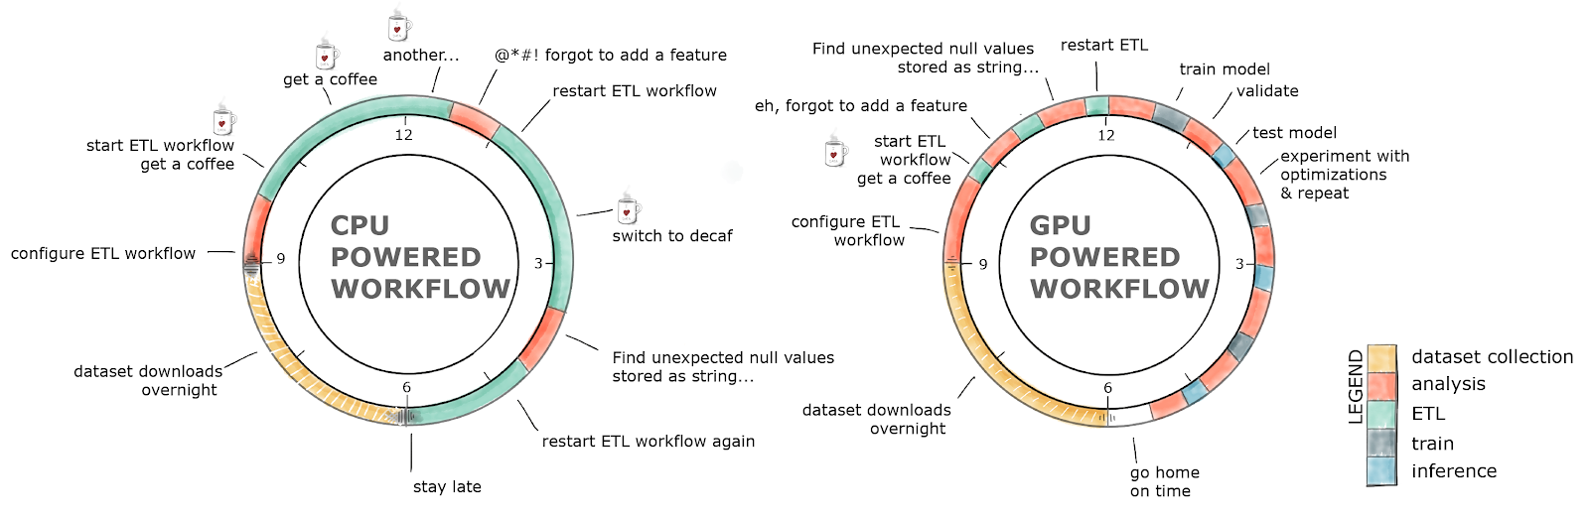
GPU-Accelerated ETL
The Average Data Scientist Spends 90+% of Their Time in ETL as Opposed to Training Models

Slide 27
ETL Technology Stack
Python
Dask cuDF
cuDF
Pandas
Cython
cuDF C++
CUDA Libraries
Thrust
Cub
Jitify
CUDA

Slide 28



ETL - the Backbone of Data Science
libcuDF is…
CUDA C++ LIBRARY
Table (dataframe) and column types and algorithms
CUDA kernels for sorting, join, groupby, reductions, partitioning, elementwise operations, etc.
Optimized GPU implementations for strings, timestamps, numeric types (more coming)
Primitives for scalable distributed ETL
std::unique_ptr<table>
gather(table_view const& input,
column_view const& gather_map, …)
{
// return a new table containing
// rows from input indexed by // gather_map
}

Slide 29
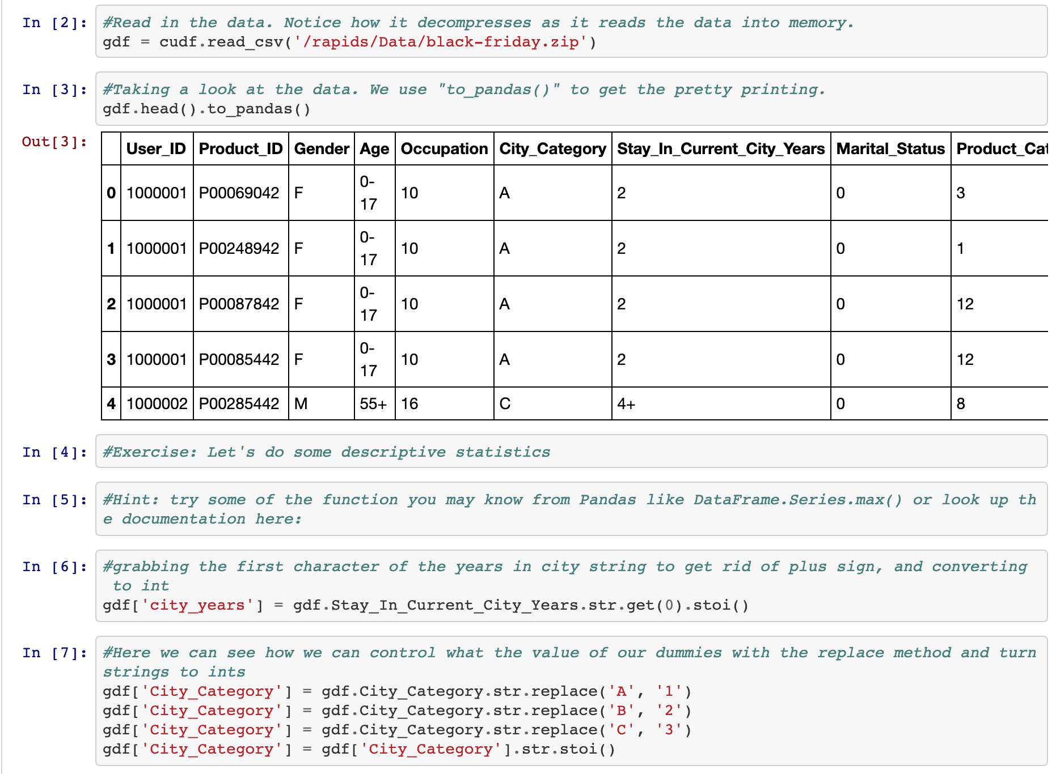
ETL - the Backbone of Data Science
cuDF is…
PYTHON LIBRARY
A Python library for manipulating GPU DataFrames following the Pandas API
Python interface to CUDA C++ library with additional functionality
Creating GPU DataFrames from Numpy arrays, Pandas DataFrames, and PyArrow Tables
JIT compilation of User-Defined Functions (UDFs) using Numba

Slide 30
Benchmarks: Single-GPU Speedup vs. Pandas
cuDF v0.13, Pandas 0.25.3
Running on NVIDIA DGX-1:
GPU: NVIDIA Tesla V100 32GB
CPU: Intel(R) Xeon(R) CPU E5-2698 v4 @ 2.20GHz
Benchmark Setup:
RMM Pool Allocator Enabled
DataFrames: 2x int32 columns key columns, 3x int32 value columns
Merge: inner; GroupBy: count, sum, min, max calculated for each value column
10M
100M
970
900
500
500
370
350
330
320
300
GPU Speedup Over CPU
0
Merge
Sort
GroupBy

Slide 31
ETL - the Backbone of Data Science
cuDF is Not the End of the Story
Data Preparation
Model Training
Visualization
Dask
cuDF cuIO
Analytics
cuML
Machine Learning
cuGraph
Graph Analytics
PyTorch, TensorFlow, MxNet
Deep Learning
cuxfilter, pyViz, plotly
Visualization
GPU Memory

Slide 32
ETL - the Backbone of Data Science
String Support
CURRENT V0.15 STRING SUPPORT
Regular Expressions
Element-wise operations
Split, Find, Extract, Cat, Typecasting, etc…
String GroupBys, Joins, Sorting, etc.
Categorical columns fully on GPU
Native String type in libcudf C++
NLP Preprocessors
Tokenizers, Normalizers, Edit Distance, Porter Stemmer, etc.
FUTURE V0.16+ STRING SUPPORT
Further performance optimization
JIT-compiled String UDFs
Pandas
Cuda Strings
800
700
600
500
400
milliseconds
300
200
100
0
Lower ()
Find(#)
Slice(1,15)

Slide 33
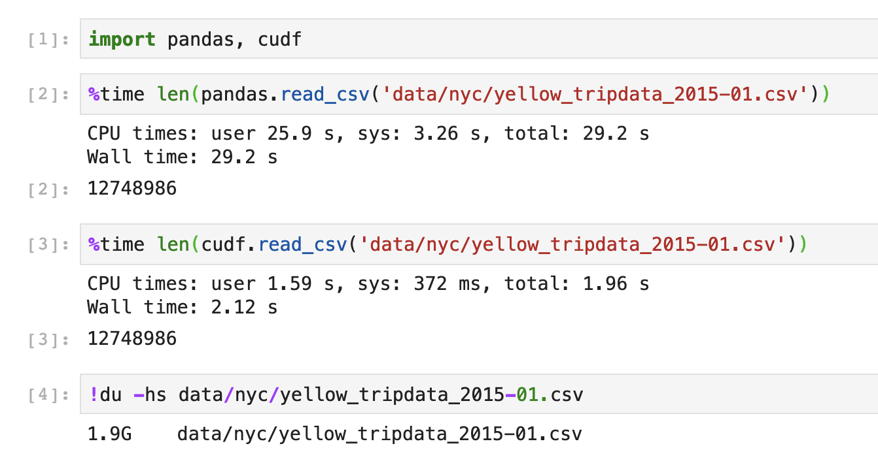
Extraction is the Cornerstone
cuIO for Faster Data Loading
Follow Pandas APIs and provide >10x speedup
CSV Reader, CSV Writer
Parquet Reader, Parquet Writer
ORC Reader, ORC Writer
JSON Reader
Avro Reader
GPU Direct Storage integration in progress for bypassing PCIe bottlenecks!
Key is GPU-accelerating both parsing and decompression
Source: Apache Crail blog: SQL Performance: Part 1 - Input File Formats
Notes:
TSVD – truncated Singular Value Decomposition DBSCAN - Density-Based Spatial Clustering of Applications with Noise

Slide 34
ETL is Not Just DataFrames!

Slide 35
RAPIDS
Building Bridges into the Array Ecosystem
Data Preparation
Model Training
Visualization
Dask
cuDF cuIO
Analytics
cuML
Machine Learning
cuGraph
Graph Analytics
PyTorch, TensorFlow, MxNet
Deep Learning
cuxfilter, pyViz, plotly
Visualization
GPU Memory

Slide 36






Interoperability for the Win
Real-world workflows often need to share data between libraries
RAPIDS supports device memory sharing between many popular data science and deep learning libraries
Keeps data on the GPU--avoids costly copying back and forth to host memory
Any library that supports DLPack or __cuda_array_interface__ will allow for sharing of memory buffers between RAPIDS and supported libraries
mpi4py

Slide 37

ETL – Arrays and DataFrames
Dask and CUDA Python Arrays
NumPy Array
Scales NumPy to distributed clusters
Used in climate science, imaging, HPC analysis up to 100TB size
Now seamlessly accelerated with GPUs
Dask Array

Slide 38
Benchmark: Single-GPU CuPy vs NumPy
800MB
8MB
800
400
270
210
190
150
150
100
66
GPU Speedup Over CPU
18
17
8.3
11
5.3
3.6
5.1
1.5
3.5
1.1
0
Elementwise
FFT
Stencil
Sum
SVD
Array Slicing
Matrix Multiplication
Standard Deviation
Operation
More details: https://blog.dask.org/2019/06/27/single-gpu-cupy-benchmarks

Slide 39
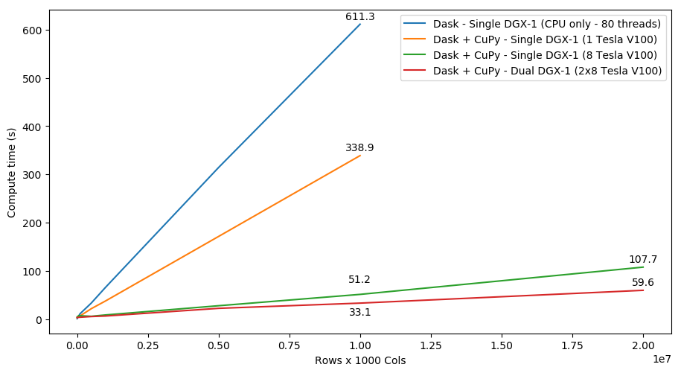
SVD Benchmark
Dask and CuPy Doing Complex Workflows

Slide 40
cuML

Slide 41
Machine Learning
More Models More Problems
Data Preparation
Model Training
Visualization
Dask
cuDF cuIO
Analytics
cuML
Machine Learning
cuGraph
Graph Analytics
PyTorch, TensorFlow, MxNet
Deep Learning
cuxfilter, pyViz, plotly
Visualization
GPU Memory

Slide 42
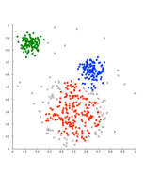
Problem
Data Sizes Continue to Grow
MASSIVE DATASET
HISTOGRAMS / DISTRIBUTIONS
Better to start with as much data as
possible and explore / preprocess to scale to performance needs.
DIMENSION REDUCTION FEATURE SELECTION
Time Increases
REMOVE OUTLIERS
Iterate. Cross Validate & Grid Search. Iterate Some More.
Hours? Days?
SAMPLING
Meet Reasonable Speed vs Accuracy Trade-off

Slide 43
ML Technology Stack
Python
Dask cuML Dask cuDF
cuDF
Numpy
Cython
cuML Algorithms
Thrust Cub cuSolver nvGraph CUTLASS cuSparse cuRand cuBlas
cuML Prims
CUDA Libraries
CUDA

Slide 44
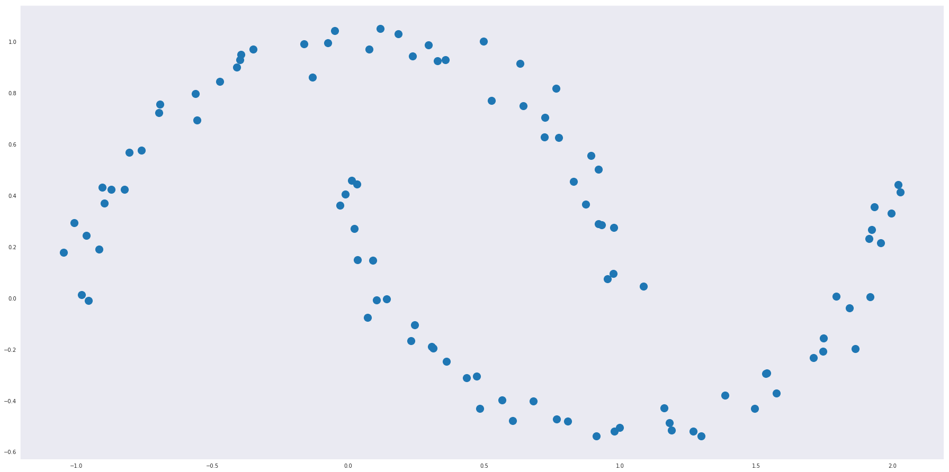
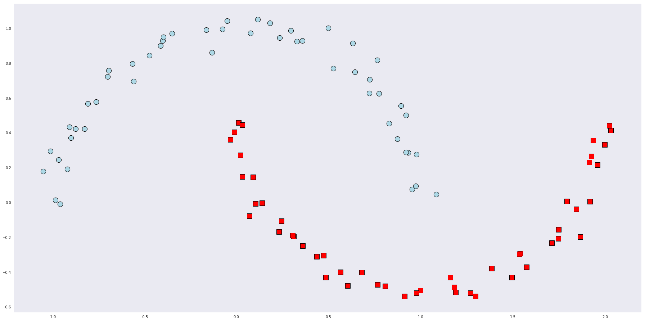
RAPIDS Matches Common Python APIs
CPU-based Clustering
from sklearn.datasets import make_moons import pandas
X, y = make_moons(n_samples=int(1e2), noise=0.05, random_state=0) X = pandas.DataFrame({'fea%d'%i: X[:, i] for i in range(X.shape[1])})
from sklearn.cluster import DBSCAN dbscan = DBSCAN(eps = 0.3, min_samples = 5) dbscan.fit(X) y_hat = dbscan.predict(X)

Slide 45
RAPIDS Matches Common Python APIs
GPU-accelerated Clustering
from sklearn.datasets import make_moons import cudf
X, y = make_moons(n_samples=int(1e2), noise=0.05, random_state=0) X = cudf.DataFrame({'fea%d'%i: X[:, i] for i in range(X.shape[1])})
from cuml import DBSCAN dbscan = DBSCAN(eps = 0.3, min_samples = 5) dbscan.fit(X) y_hat = dbscan.predict(X)

Slide 46

Algorithms
GPU-accelerated Scikit-Learn
Classification / Regression
Decision Trees / Random Forests
Linear/Lasso/Ridge/ElasticNet Regression
Logistic Regression
K-Nearest Neighbors
Support Vector Machine Classification and Regression
Naive Bayes
Inference
Random Forest / GBDT Inference (FIL)
Preprocessing
Text vectorization (TF-IDF / Count)
Target Encoding
Cross-validation / splitting
Clustering
Decomposition & Dimensionality Reduction
K-Means
DBSCAN
Spectral Clustering
Principal Components
Singular Value Decomposition UMAP
Spectral Embedding
T-SNE
Cross Validation
Hyper-parameter Tuning
Time Series
Holt-Winters
Seasonal ARIMA / Auto ARIMA
More to come!
Key: Preexisting | NEW or enhanced for 0.15

Slide 47
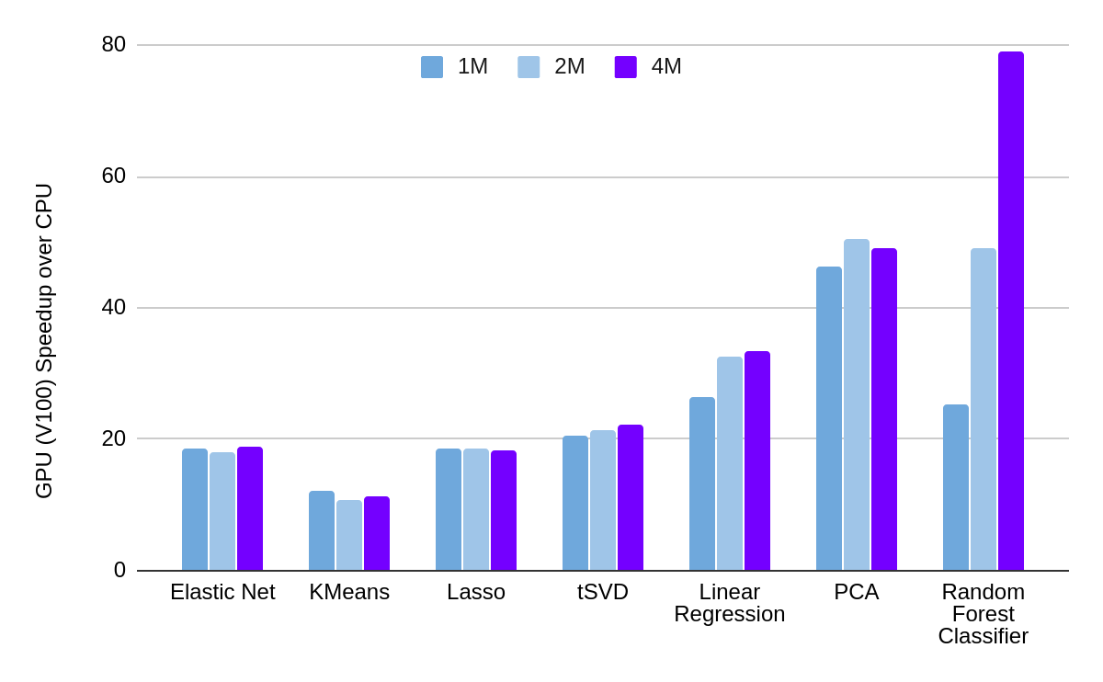
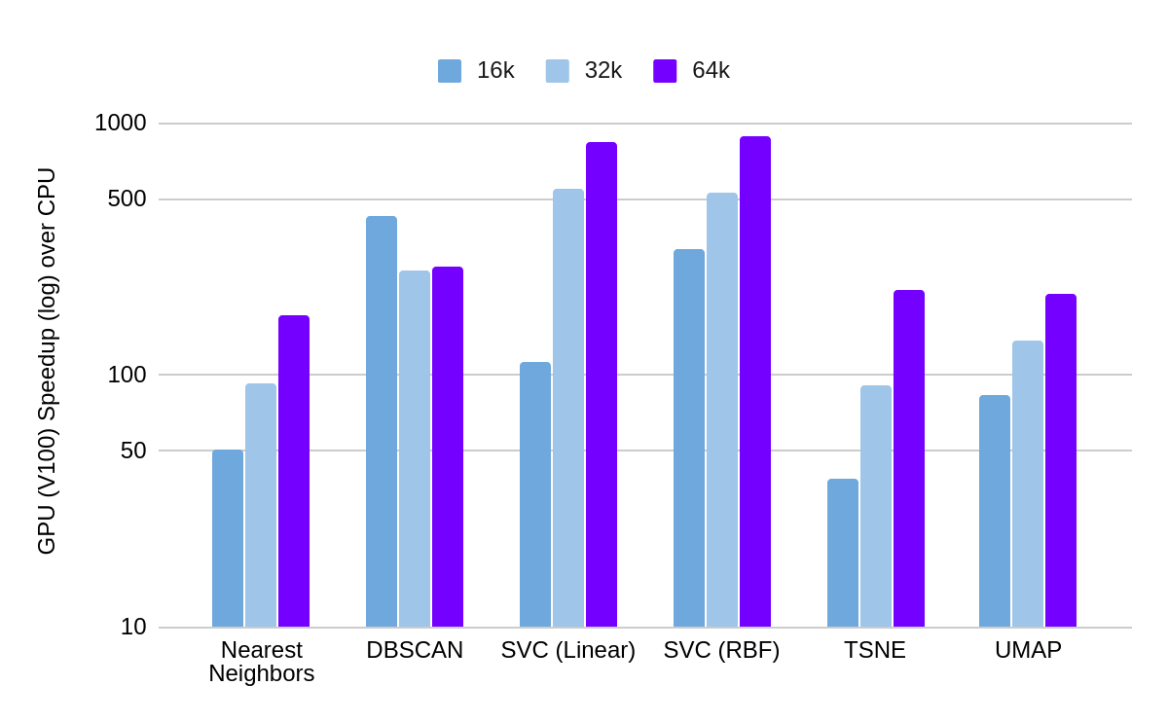
Benchmarks: Single-GPU cuML vs Scikit-learn (WIP)
1x V100 vs. 2x 20 Core CPUs (DGX-1, RAPIDS 0.15)

Slide 48
Forest Inference
Taking Models From Training to Production
cuML’s Forest Inference Library accelerates prediction (inference) for random forests and boosted decision trees:
Works with existing saved models (XGBoost, LightGBM, scikit-learn RF cuML RF soon)
Lightweight Python API
Single V100 GPU can infer up to 34x faster than XGBoost dual-CPU node
Over 100 million forest inferences
XGBoost CPU Inference vs. FIL GPU (1000 trees)
CPU Time (XGBoost, 40 Cores)
FIL GPU Time (1x V100)
4000
23x
34x
23x
3000
36x
Time (ms)
2000
1000
0
Bosch
Airline
Higgs
Epsilon
Notes:
DGX-1, 2x E5-2698 v4 @ 2.20GHz, V100-32GB, using FIL BATCH_REORG algo, 1000 trees, max_depth=10
Trained in XGBoost using data from https://github.com/NVIDIA/gbm-bench
Release 0.9

Slide 49
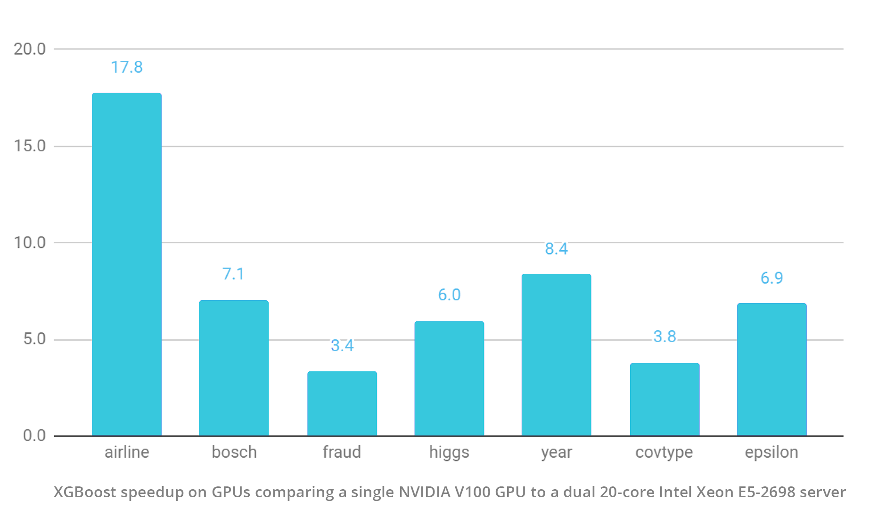
XGBoost + RAPIDS: Better Together
RAPIDS comes paired with XGBoost 1.1 (as of 0.14)
XGBoost now builds on the GoAI interface standards to provide zero-copy data import from cuDF, cuPY, Numba, PyTorch and more
Official Dask API makes it easy to scale to multiple nodes or multiple GPUs
gpu_hist tree builder delivers huge perf gains Memory usage when importing GPU data decreased by 2/3 or more
New objectives support Learning to Rank on GPU
All RAPIDS changes are integrated upstream and provided to all XGBoost users – via pypi or RAPIDS conda

Slide 50
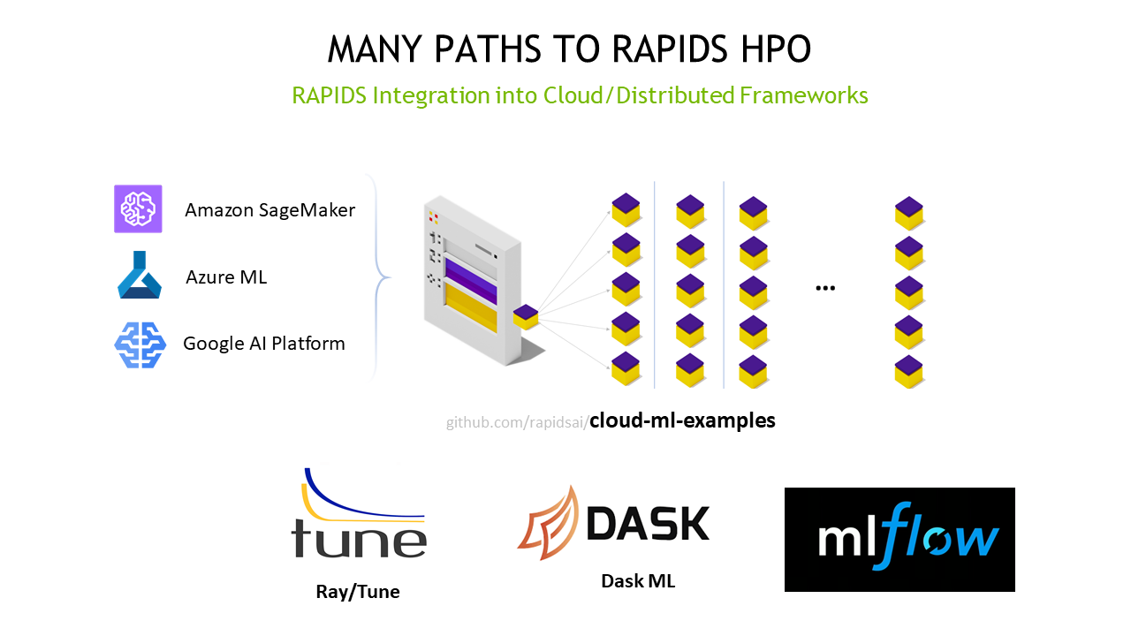

RAPIDS Integrated into Cloud ML Frameworks
Accelerated machine learning models in RAPIDS give you the flexibility to use hyperparameter optimization (HPO) experiments to explore all variants to find the most accurate possible model for your problem.
With GPU acceleration, RAPIDS models can train 40x faster than CPU equivalents, enabling more experimentation in less time.
The RAPIDS team works closely with major cloud providers and OSS solution providers to provide code samples to get started with HPO in minutes
https://rapids.ai/hpo

Slide 51
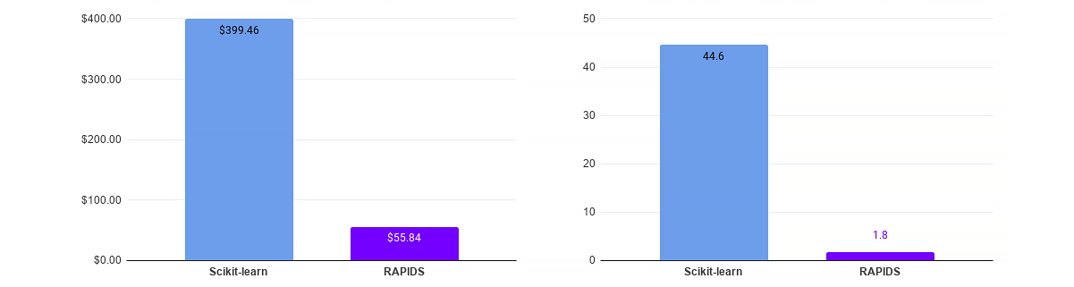
HPO Use Case: 100-Job Random Forest Airline Model
Huge speedups translate into >7x TCO reduction
Based on sample Random Forest training code from cloud-ml-examples repository, running on Azure ML. 10 concurrent workers with 100 total runs, 100M rows, 5-fold cross-validation per run. GPU nodes: 10x Standard_NC6s_v3, 1 V100 16G, vCPU 6 memory 112G, Xeon E5-2690 v4 (Broadwell) - $3.366/hour CPU nodes: 10x Standard_DS5_v2, vCPU 16 memory 56G, Xeon E5-2673 v3 (Haswell) or v4 (Broadwell) - $1.017/hour"

Slide 52
Road to 1.0 - cuML
June 2020 - RAPIDS 0.15
cuML | Single-GPU | Multi-Node-Multi-GPU
Gradient Boosted Decision Trees (GBDT)
Linear Regression
Logistic Regression
Random Forest
K-Means
K-NN
DBSCAN
UMAP
Holt-Winters
ARIMA
T-SNE
Principal Components
Singular Value Decomposition
SVM

Slide 53
Road to 1.0 - cuML
2020 EOY Plan
cuML | Single-GPU | Multi-Node-Multi-GPU
Gradient Boosted Decision Trees (GBDT)
Linear Regression
Logistic Regression
Random Forest
K-Means
K-NN
DBSCAN
UMAP
Holt-Winters
ARIMA
T-SNE
Principal Components
Singular Value Decomposition
SVM

Slide 54
cuGraph

Slide 55
Graph Analytics
More Connections, More Insights
Data Preparation
Model Training
Visualization
Dask
cuDF cuIO
Analytics
cuML
Machine Learning
cuGraph
Graph Analytics
PyTorch, TensorFlow, MxNet
Deep Learning
cuxfilter, pyViz, plotly
Visualization
GPU Memory

Slide 56
Goals and Benefits of cuGraph
Focus on Features and User Experience
MULTIPLE APIs
Python: Familiar NetworkX-like API
C/C++: lower-level granular control for application developers
GROWING FUNCTIONALITY
Extensive collection of algorithm, primitive, and utility functions
BREAKTHROUGH PERFORMANCE
Up to 500 million edges on a single 32GB GPU
Multi-GPU support for scaling into the billions of edges
SEAMLESS INTEGRATION WITH cuDF AND cuML
Property Graph support via DataFrames

Slide 57
Graph Technology Stack
Python
Dask cuGraph Dask cuDF
cuDF
Numpy
Cython
cuGraph Algorithms
Prims
cuGraphBLAS⁺
cuHornet
Thrust Cub cuSolver cuSparse cuRand Gunrock*
CUDA Libraries
CUDA
+cuGraphBLAS is still in development and will be ready late 2020
* Gunrock is from UC Davis

Slide 58
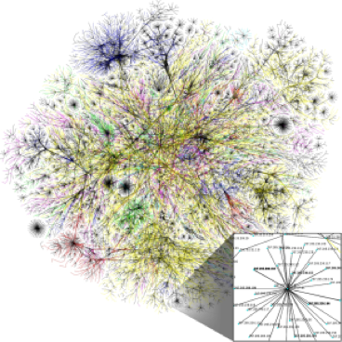
Algorithms
GPU-accelerated NetworkX
Community
Spectral Clustering - Balanced Cu and Modularity Maxim
Louvain and Leiden
Ensemble Clustering for Graphs
KCore and KCore Number
Triangle Counting
K-Truss
Components
Weakly Connected Components
Strongly Connected Components
Link Analysis
Page Rank (Multi-GPU)
Personal Page Rank
HITS
Graph Classes
Subgraph Extraction
Structure
Link Prediction
Jaccard
Weighted Jaccard
Overlap Coefficient
Renumbering
Auto-Renumbering
Force Atlas 2
Utilities
Traversal
Single Source Shortest Path (SSSP)
Breadth First Search (BFS)
Centrality
Katz
Betweenness Centrality (Vertex and Edge)

Slide 59
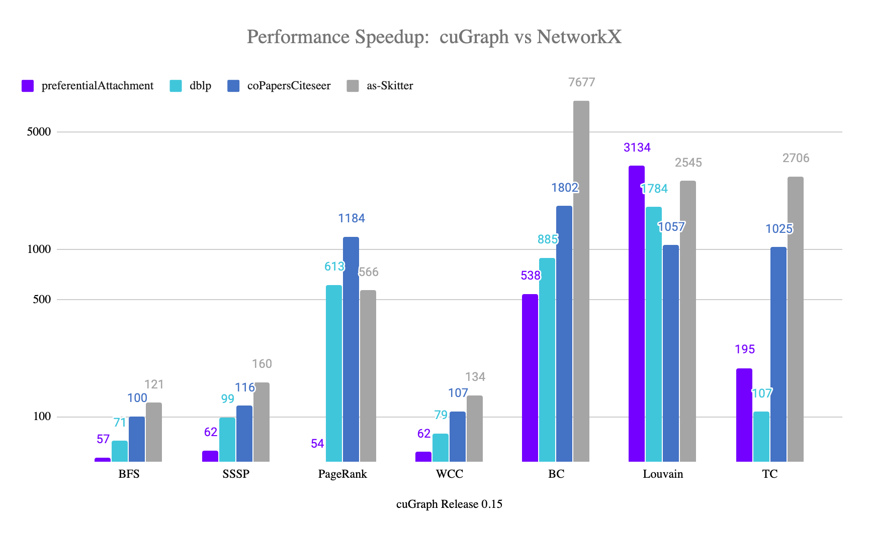
Benchmarks: Single-GPU cuGraph vs NetworkX
Performance Speedup: cuGraph vs NetworkX
Dataset | Nodes | Edges
preferentialAttachment | 100,000 | 999,970
Dblp-2010 | 326,186 | 1,615,400
coPapersCiteseer | 434,102 | 32,073,440
As-Skitter | 1,696,415 | 22,190,596

Slide 60
Multi-GPU PageRank Performance
PageRank Portion of the HiBench Benchmark Suite
HiBench Scale | Vertices | Edges | CSV File (GB) | # of GPUs | # of CPU Threads | Pagerank for 3 Iterations (secs)
Huge | 5,000,000 | 198,000,000 | 3 | 1 |  | 1.1
BigData | 50,000,000 | 1,980,000,000 | 34 | 3 |  | 5.1
BigData x2 | 100,000,000 | 4,000,000,000 | 69 | 6 |  | 9.0
BigData x4 | 200,000,000 | 8,000,000,000 | 146 | 12 |  | 18.2
BigData x8 | 400,000,000 | 16,000,000,000 | 300 | 16 |  | 31.8
BigData x8 | 400,000,000 | 16,000,000,000 | 300 |  | 800* | 5760*
*BigData x8, 100x 8-vCPU nodes, Apache Spark GraphX ⇒ 96 mins!

Slide 61
Road to 1.0
December 2019 - RAPIDS 0.15
cuGRAPH | Single-GPU
Page Rank
Personal Page Rank
Katz
Betweenness Centrality
Spectral Clustering
Louvain
Ensemble Clustering for Graphs
K-Truss & K-Core
Connected Components (Weak & Strong)
Triangle Counting
Single Source Shortest Path (SSSP)
Breadth-First Search (BFS)
Jaccard & Overlap Coefficient
Force Atlas 2
Leiden

Slide 62
Road to 1.0
2020 EOY Plan
cuGRAPH | Single-GPU | Multi-Node-Multi-GPU
Page Rank
Personal Page Rank
Katz
Betweenness Centrality
Spectral Clustering
Louvain
Ensemble Clustering for Graphs
K-Truss & K-Core
Connected Components (Weak & Strong)
Triangle Counting
Single Source Shortest Path (SSSP)
Breadth-First Search (BFS)
Jaccard & Overlap Coefficient
Force Atlas 2
Hungarian Algorithm
Leiden

Slide 63
cuSpatial

Slide 64
cuSpatial Technology Stack
Python
Cython
cuSpatial
cuDF C++
Thrust
CUDA

Slide 65
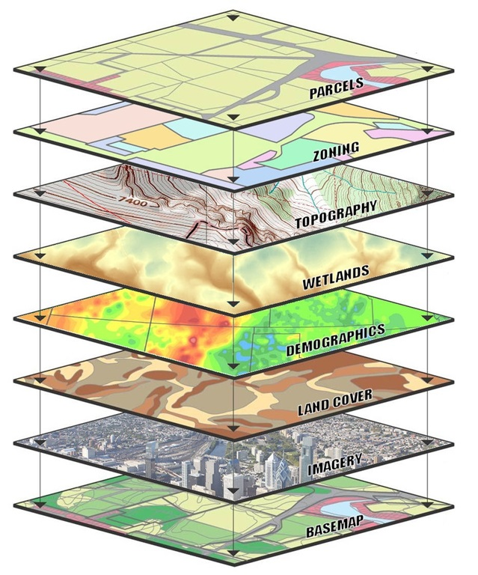
cuSpatial
BREAKTHROUGH PERFORMANCE & EASE OF USE
Up to 1000x faster than CPU spatial libraries
Python and C++ APIs for maximum usability and integration
GROWING FUNCTIONALITY
Extensive collection of algorithm, primitive, and utility functions for spatial analytics
SEAMLESS INTEGRATION INTO RAPIDS
cuDF for data loading, cuGraph for routing optimization, and cuML for clustering are just a few examples

Slide 66
cuSpatial
0.15 and Beyond
Layer | 0.15 Functionality | Functionality Roadmap (0.16)
High-level Analytics | C++ Library w. Python bindings enabling distance, speed, trajectory similarity, trajectory clustering | Symmetric segment path distance
Graph Layer | cuGraph | cuGraph
Query Layer | Spatial Window, Nearest polyline | Nearest Neighbor, Spatiotemporal range search and joins
Index Layer | Quadtree
Geo-operations | Point in polygon (PIP), Haversine distance, Hausdorff distance, lat-lon to xy transformation | ST_distance and ST_contains
Geo-Representation | Shape primitives, points, polylines, polygons | Fiona/Geopandas I/O support and object representations

Slide 67
cuSpatial
Performance at a Glance
cuSpatial Operation | Input Data | cuSpatial Runtime | Reference Runtime | Speedup
Point-in-Polygon Test | 1.3+ million vehicle point locations and 27 Region of Interests | 1.11 ms (C++) 1.50 ms (Python) [Nvidia Titan V] | 334 ms (C++, optimized serial) 130468.2 ms (python Shapely API, serial) [Intel i7-7800X] | 301X (C++) 86,978X (Python)
Haversine Distance Computation | 13+ million Monthly NYC taxi trip pickup and drop-off locations | 7.61 ms (Python) [Nvidia T4] | 416.9 ms (Numba) [Nvidia T4] | 54.7X (Python)
Hausdorff Distance Computation (for clustering) | 52,800 trajectories with 1.3+ million points | 13.5s [Quadro V100] | 19227.5s (Python SciPy API, serial) [Intel i7-6700K] | 1,400X (Python)

Slide 68
cuSignal

Slide 69
cuSignal Technology Stack
Python
Numba
CuPy
CUDA
Unlike other RAPIDS libraries, cuSignal is purely developed in Python
with custom CUDA Kernels written with Numba and CuPy (notice no Cython layer).

Slide 70

cuSignal – Selected Algorithms
GPU-accelerated SciPy Signal
Convolution
Convolve/Correlate
FFT Convolve
Convolve/Correlate 2D
Resampling – Polyphase, Upfirdn, Resample
Hilbert/Hilbert 2D
Wiener
Firwin
Filtering and Filter Design
Waveform Generation
Chirp
Square
Gaussian Pulse
Kaiser
Blackman
Hamming
Hanning
Wavelets
Window Functions
Peak Finding
Spectral Analysis
Periodogram
Welch
Spectrogram
More to come!
Notes:
This is a non-exhaustive list of features
Perf, 1e8 points (Python, using time, with garbage collection).
Fftconvolve – 76x
Correlate – 53x
Resample – 51x
Polyphase resample – 14x
Welch Spectrum estimation – 26x
Spectrogram – 15x
Continuous wavelet transform – 89x

Slide 71
Speed of Light Performance – V100
timeit (7 runs) rather than time. Benchmarked with ~1e8 sample signals on a DGX Station
Method | Scipy Signal (ms) | cuSignal (ms) | Speedup (xN)
fftconvolve | 27300 | 85.1 | 320.8
correlate | 4020 | 47.4 | 84.8
resample | 14700 | 45.9 | 320.2
resample_poly | 2360 | 8.29 | 284.6
welch | 4870 | 45.5 | 107.0
spectrogram | 2520 | 23.3 | 108.1
convolve2d | 8410 | 9.92 | 847.7
Learn more about cuSignal functionality and performance by browsing the notebooks

Slide 72
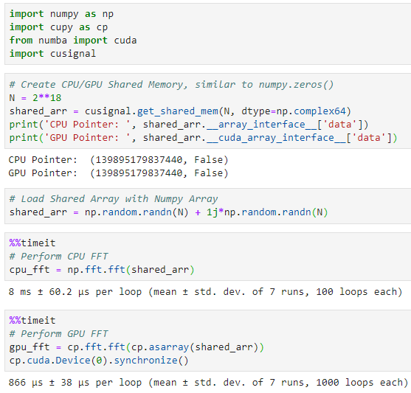
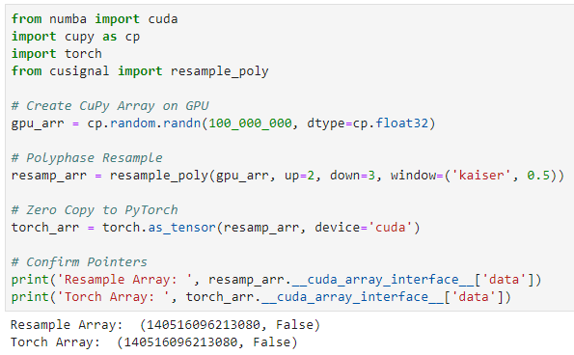
Efficient Memory Handling
Seamless Data Handoff from cuSignal to PyTorch >=1.4
Enabling Online Signal Processing with Zero-Copy Memory
Leveraging the __cuda_array_interface__ for Speed of Light End-to-End Performance
CPU <-> GPU Direct Memory Access with Numba’s Mapped Array

Slide 73
Cyber Log Accelerators

Slide 74


















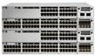


CLX
Cyber Log Accelerators
Built using RAPIDS and GPU-accelerated platforms
Targeted towards Senior SOC (Security Operations Center) Analysts, InfoSec Data Scientists, Threat Hunters, and Forensic Investigators
Notebooks geared towards info sec and cybersecurity data scientists and data engineer
SIEM integrations that enable easy data import/export and data access
Workflow and I/O components that enable users to instantiate new use cases while
Cyber-specific primitives that provide accelerated functions across cyber data types
File Stores
Existing DS and ML/DL Software
GPU-target Packages
Long-term Data Store
Network Sensors

Slide 75
CLX Technology Stack
CLX Applications / Use Cases
Security Products
and SIEMs
Python
Cython
RAPIDS
GPU Packages
CUDA Libraries
CUDA

Slide 76
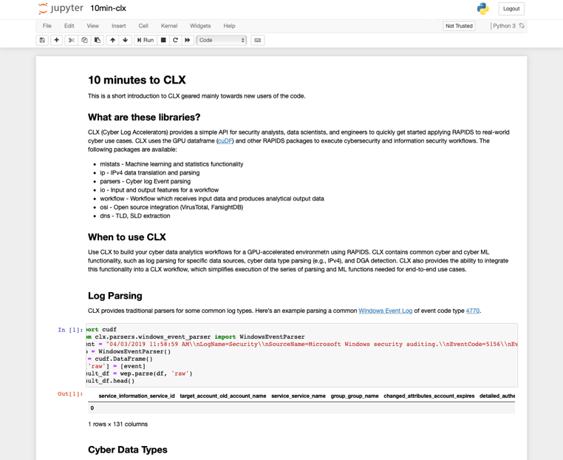
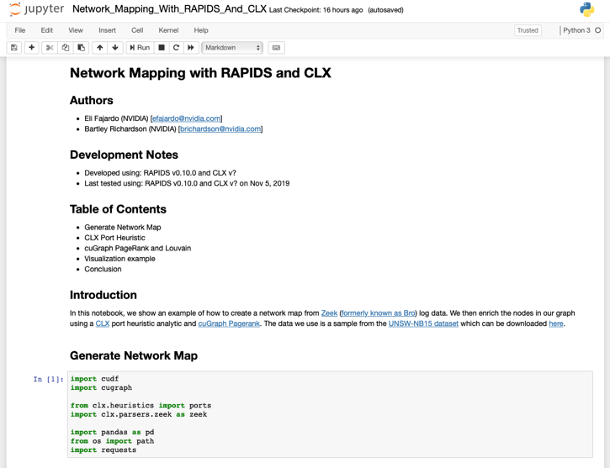
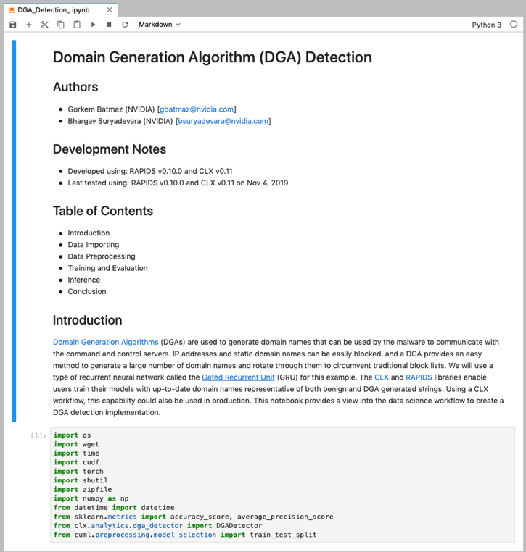
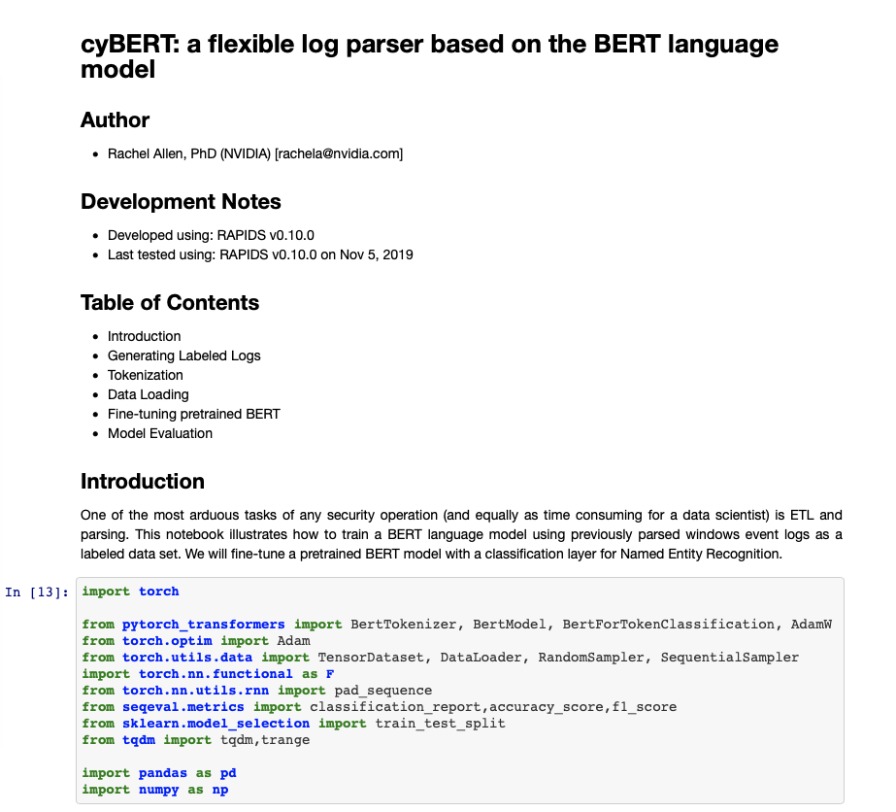
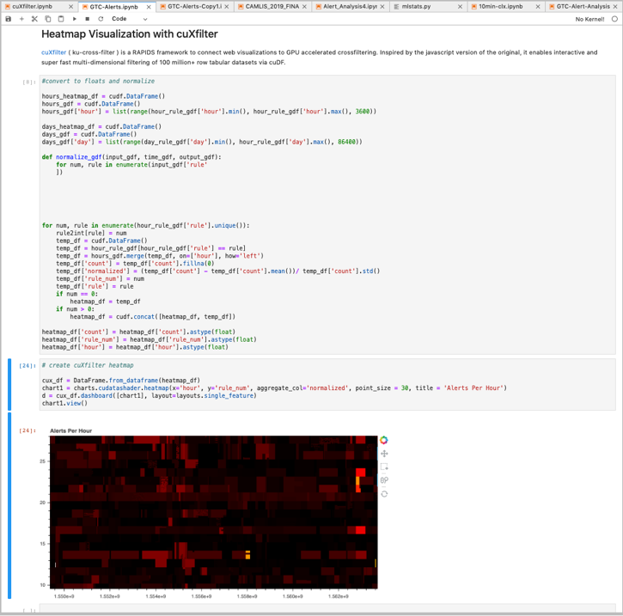
CLX Contains Various Use Cases and Connectors
Example Notebooks Demonstrate RAPIDS for Cybersecurity Applications
CLX | Type | Proof-of-Concept | Stable
DGA Detection | Use Case
Network Mapping | Use Case
Asset Classification | Use Case
Phishing Detection | Use Case
Security Alert Analysis | Use Case
Splunk Integration | Integration
CLX Query | Integration
cyBERT | Log Parsing
GPU Wordpiece Tokenizer | Pre-Processing
Accelerated IPv4 | Primitive
Accelerated DNS | Primitive

Slide 77

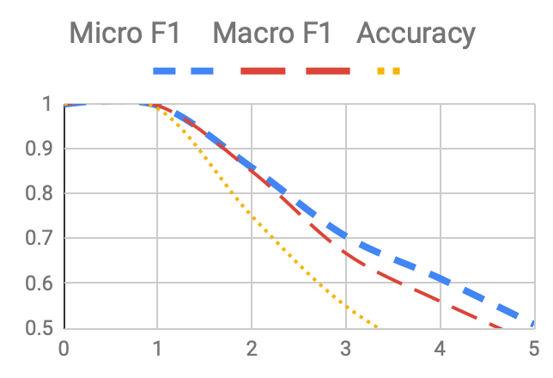
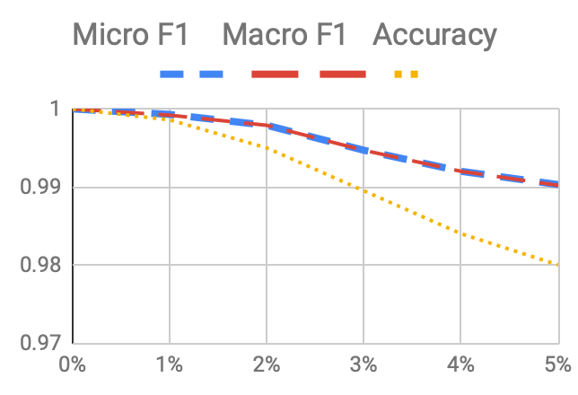
cyBERT
AI Log Parsing for Known, Unknown, and Degraded Cyber Logs
Provide a flexible method that does not use heuristics/regex to parse cybersecurity logs
Built using RAPIDS and PyTorch, tested with a variety of language models (including BERT)
Parsing with micro-F1 and macro-F1 > 0.999 across heterogeneous log types with a validation loss of < 0.0048
Second version ~160x (min) faster than first version due to creation of the first all-GPU wordpiece tokenizer that supports non-truncation of logs/sentences
Log Parsing with Inserted Values
Log Parsing with Missing Values

Slide 78
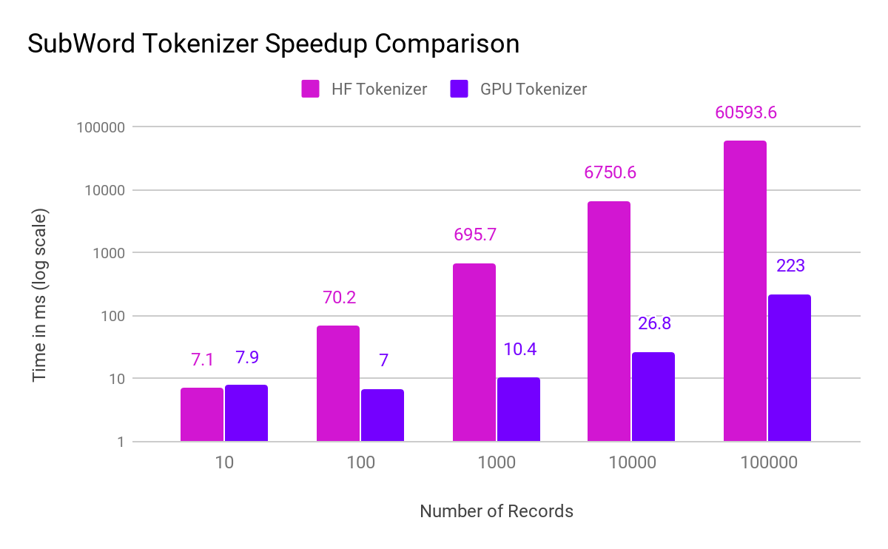
GPU SubWord Tokenizer
Fully On-GPU Pre-Processing for BERT Training/Inference
271x faster
Only wordpiece tokenizer that supports non-truncation of logs/sentences
Returns encoded tensor, attention mask, and metadata to reform broken logs
Supports stride/overlap
Ready for immediate pipelining into PyTorch for inference
Up to 270x faster than production-ready Hugging Face wordpiece tokenizer (Python version)
CPU numbers ran on 2x Intel Xeon E5 v4 @ 2.2 GHz. GPU numbers ran on 1x NVIDIA Tesla V100

Slide 79

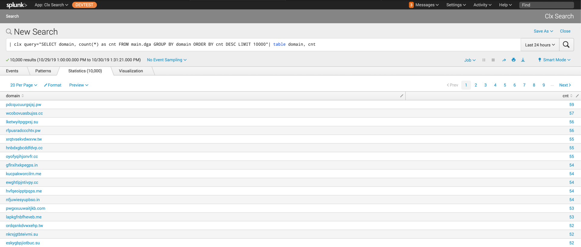


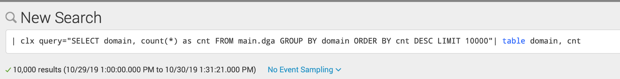
CLX Query
Query Long-Term Data Store Directly from Splunk

Slide 80
Visualization

Slide 81
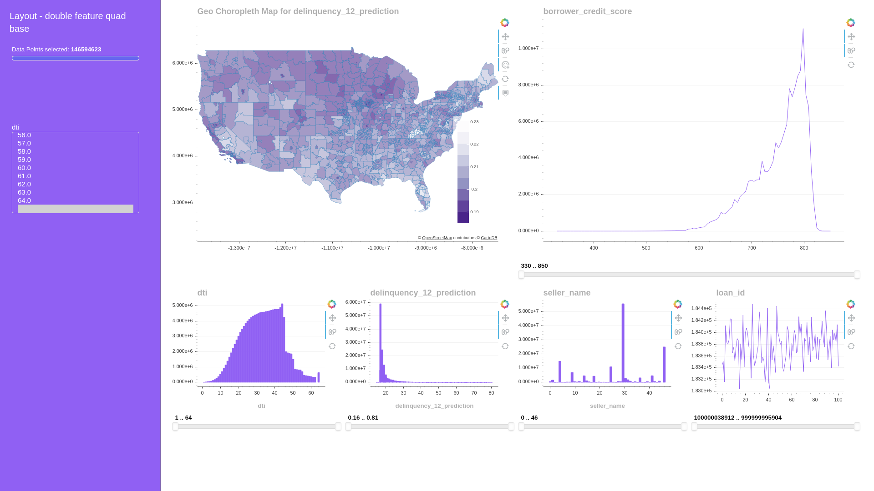
cuXfilter
GPU Accelerated Cross-Filtering
STREAMLINED FOR NOTEBOOKS
Cuxfilter allows you to visually explore your cuDF dataframes through fully cross-filtered dashboards in less than 10 lines of notebook code.
MINIMAL COMPLEXITY & FAST RESULTS
Select from vetted chart libraries, pre-designed layouts, and multiple themes to find the best fit for a use case, at speeds typically 20x faster per chart than Pandas.
SEAMLESS INTEGRATION WITH RAPIDS
Cuxfilter is designed to be easy to install and use with RAPIDS. Learn more about our approach here.
https://docs.rapids.ai/api/cuxfilter/stable

Slide 82
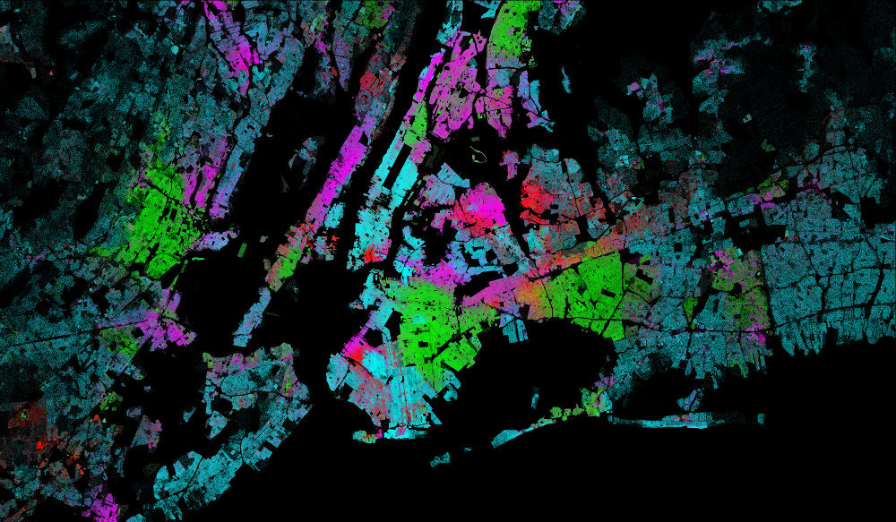
pyViz Integrations
GPU Accelerated Python Visualizations
ACCELERATED PYTHON VIZ
The RAPIDS focus on python makes it straightforward to integrate GPU acceleration for most python visualization libraries. We are currently collaborating with bokeh, plotly, and datashader, among others.
HIGHLIGHT: DATASHADER INTEGRATION
Datashader's ability to visualize billions of points makes it well suited for GPU acceleration. It now includes cuDF integration as well as other enhanced capabilities that offer between a 10-120x speed up. More details here.
https://datashader.org/

Slide 83
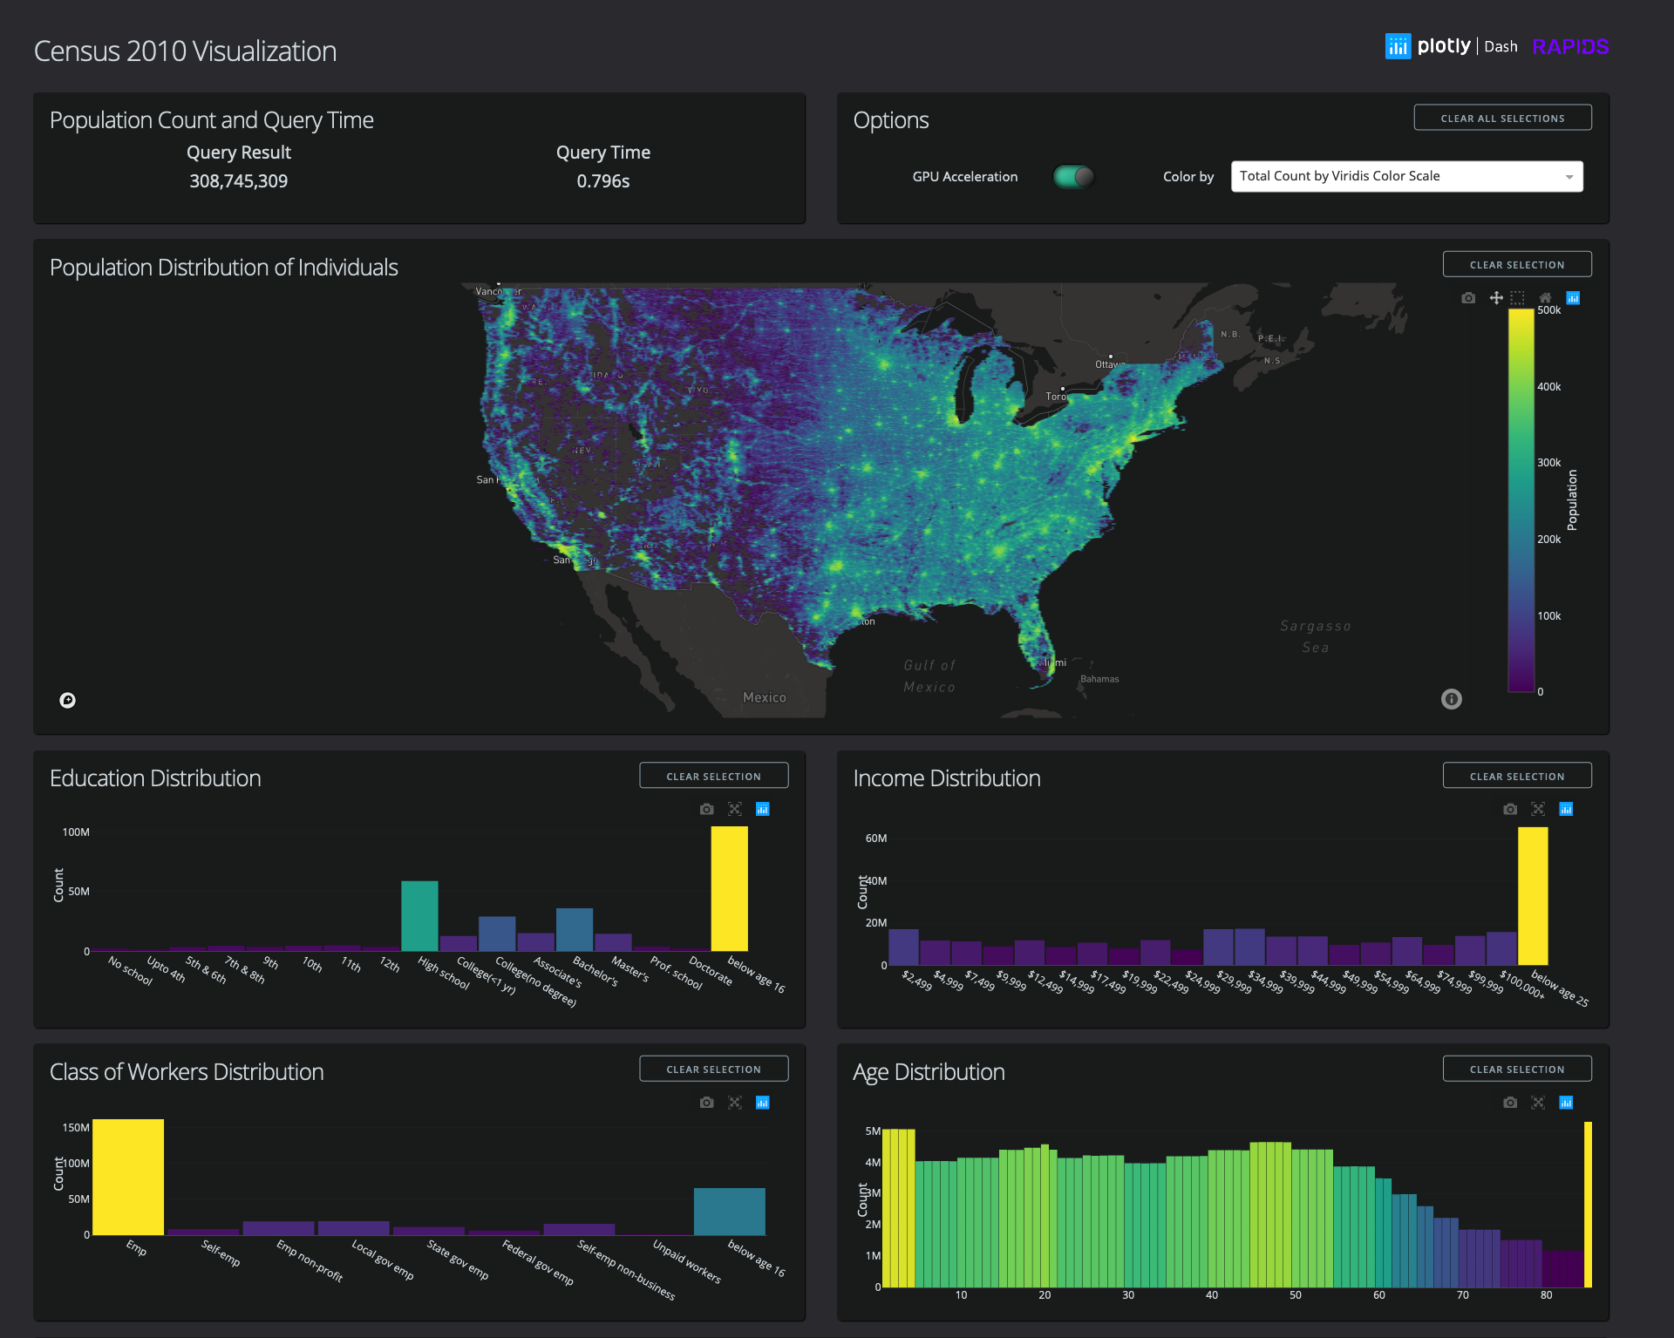
Plotly Dash
GPU Accelerated Visualization Apps with Python
PLOTLY & RAPIDS PARTNERSHIP
Plotly Dash now has RAPIDS acceleration, enabling the ease-of-use development and deployment of Dash apps, with the speed of RAPIDS. Find out more on RAPIDS.ai and Plotly’s announcement.
300 MILLION DATAPOINT CENSUS EXAMPLE
Interact with data points of every individual in the United States, in real time, with the 2010 Census visualization. Get the code on GitHub and read about details here.
https://github.com/rapidsai/plotly-dash-rapids-census-demo

Slide 84
Community

Slide 85




























Ecosystem Partners
CONTRIBUTORS
ADOPTERS
OPEN SOURCE

Slide 86
Building on Top of RAPIDS
A Bigger, Better, Stronger Ecosystem for All
Streamz
NVTabular
ETL library for recommender systems building off of RAPIDS and Dask
GPU accelerated SQL engine built on top of RAPIDS
Distributed stream processing using RAPIDS and Dask

Slide 87
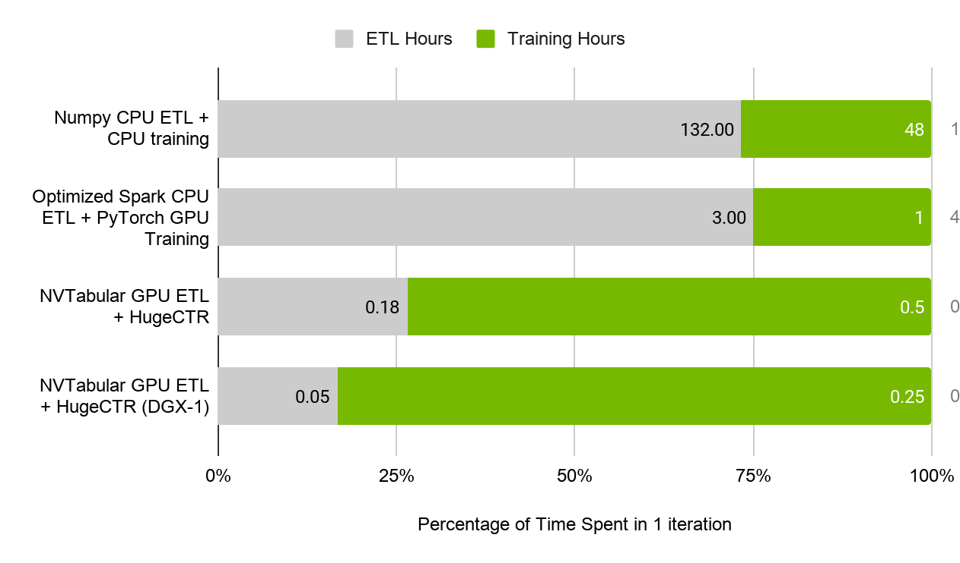
NVTabular
ETL library for recommender systems building off of RAPIDS and Dask
A HIGH LEVEL API BUILDING UPON DASK-CUDF
NVTabular’s high level API allows users to think about what they want to do with the data, not how they have to do it or how to scale it, for operations common within recommendation workflows.
ACCELERATED GPU DATALOADERS
Using cuIO primatives and cuDF, NVTabular accelerates dataloading for PyTorch & Tensorflow, removing I/O issues common in deep learning based recommender system models.

Slide 88
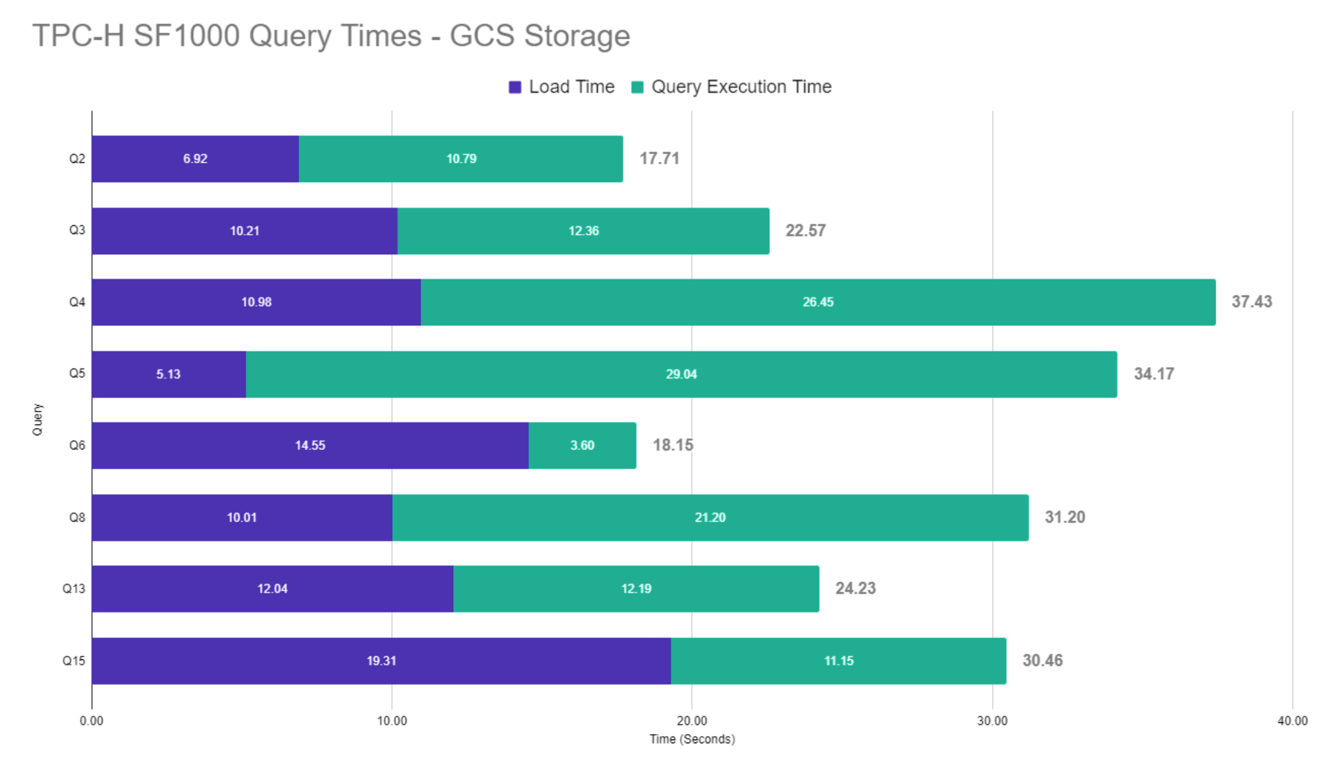
BlazingSQL
GPU-accelerated SQL engine built with RAPIDS
BLAZING FAST SQL ON RAPIDS
Incredibly fast distributed SQL engine on GPUs--natively compatible with RAPIDS!
Allows data scientists to easily connect large-scale data lakes to GPU-accelerated analytics
Directly query raw file formats such as CSV and Apache Parquet inside Data Lakes like HDFS and AWS S3, and directly pipe the results into GPU memory.
NOW WITH OUT-OF-CORE EXECUTION
Users no longer limited by available GPU memory
10TB workloads on a single Tesla V100 (32GB)!

Slide 89


BlazingSQL
YOUR
DATA
ETL
MACHINE
LEARNING
Feature
Engineering
BlazingSQL
cuDF
cuML
CSV
GDF
Parquet
ORC
JSON
from blazingsql import BlazingContext import cudf bc = BlazingContext() bc.s('bsql', bucket_name='bsql', access_key_id='<access_key>', secret_key='<secret_key') bc.create_table('orders', s3://bsql/orders/') gdf = bc.sql('select * from orders').get()

Slide 90
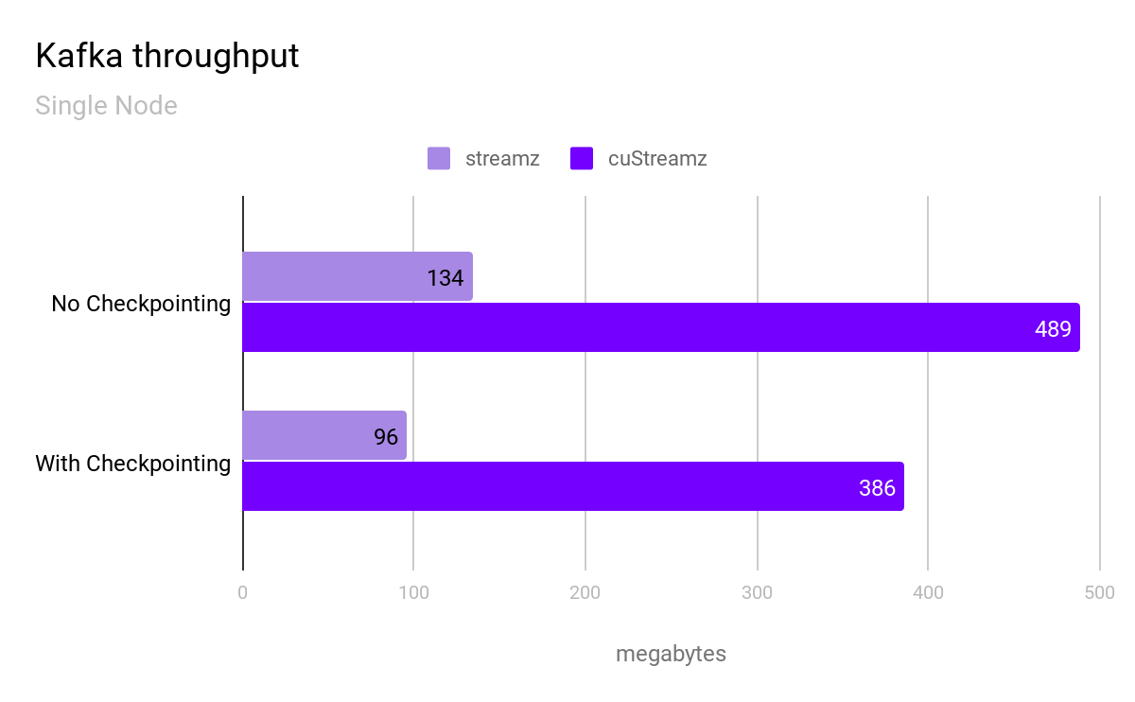
cuStreamz
Stream processing powered by RAPIDS
ACCELERATED KAFKA CONSUMER
Ingesting Kafka messages to cudf is increased by roughly 3.5 - 4X over standard cpu ingestion. Streaming TCO is lowered by using cheaper VM instance types.
CHECKPOINTING
Streaming job version of “where was I?” Streams can gracefully handle errors by continuing to process a stream at the exact point they were before the error occurred.

Slide 91




Join the Conversation
GOOGLE GROUPS
DOCKER HUB
SLACK CHANNEL
STACK OVERFLOW
https://groups.google.com/forum/#!forum/rapidsai
https://hub.docker.com/r/rapidsai/rapidsai
https://rapids-goai.slack.com/join
https://stackoverflow.com/tags/rapids

Slide 92
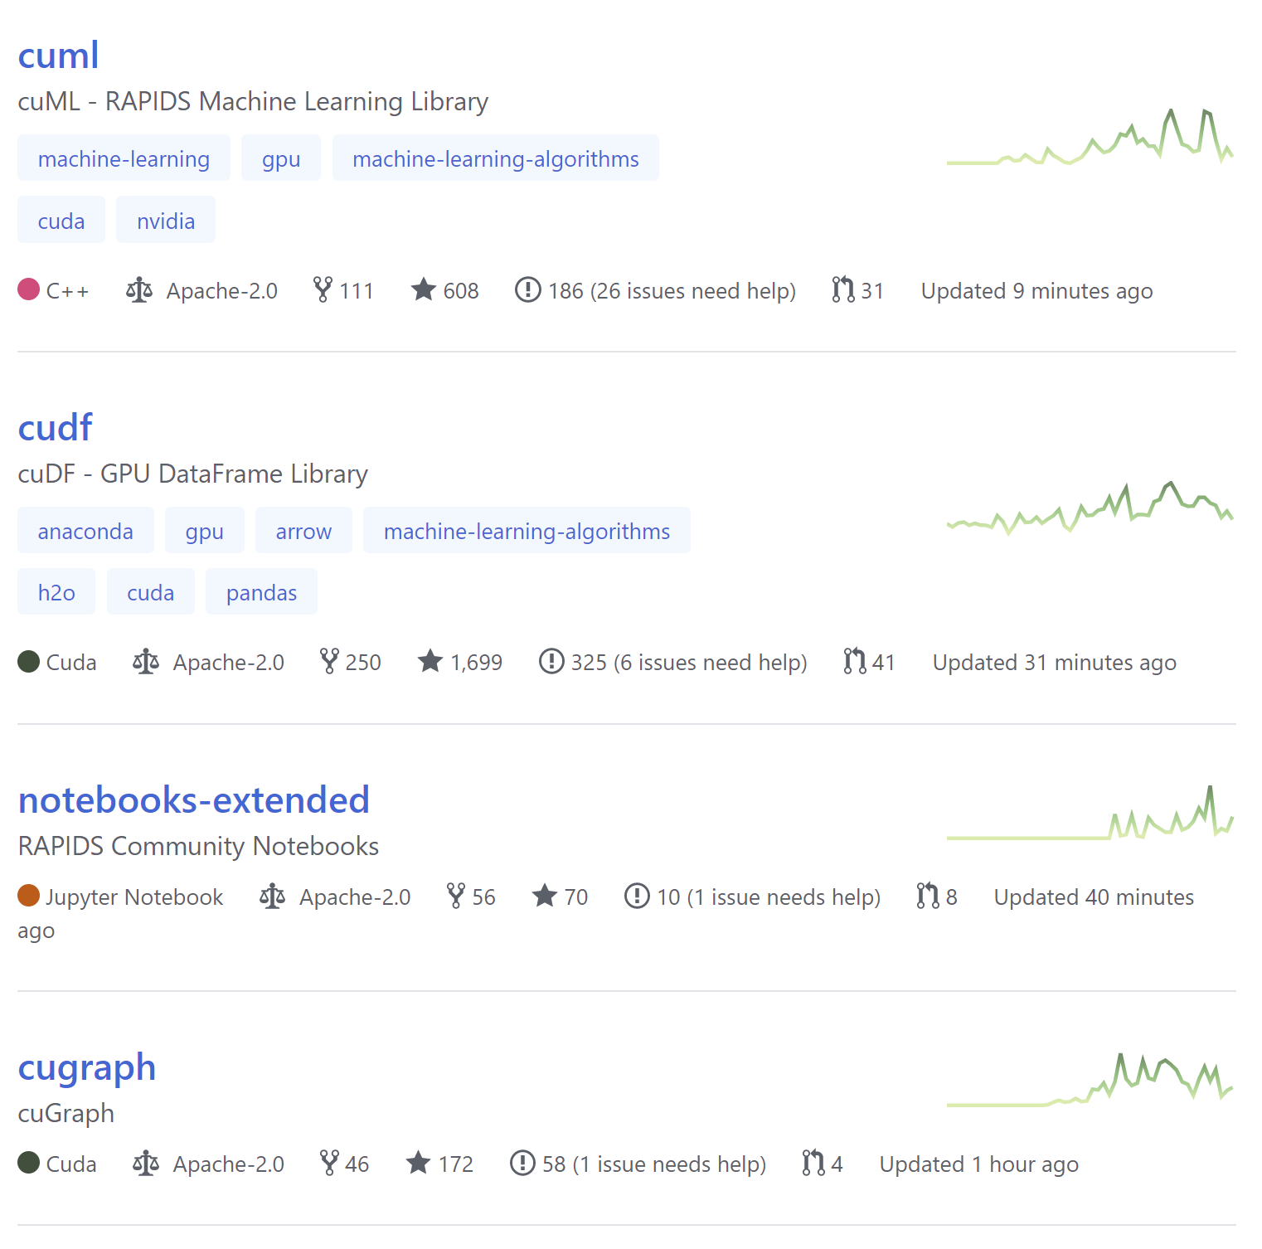
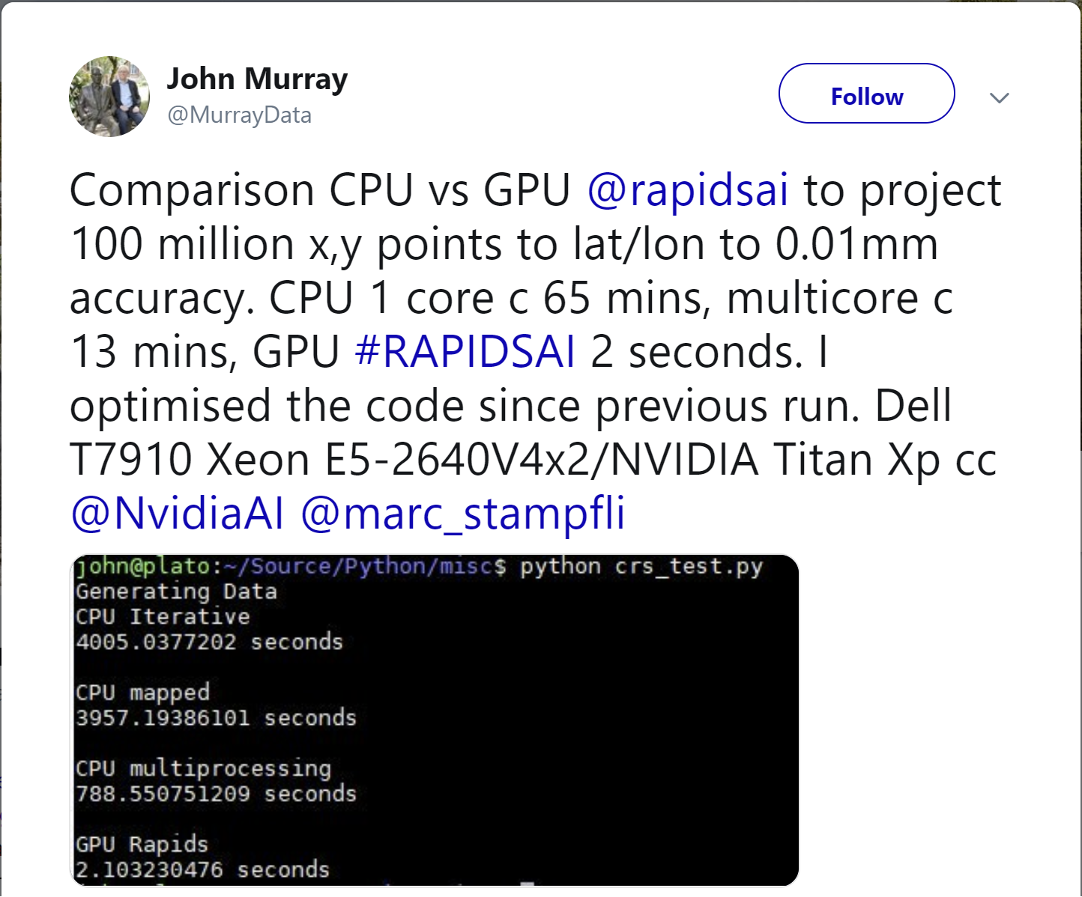
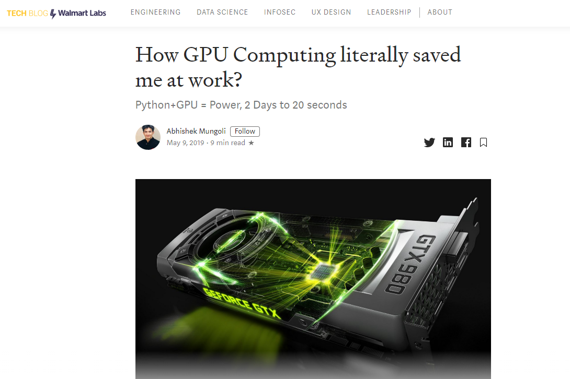

Contribute Back
Issues, Feature Requests, PRs, Blogs, Tutorials, Videos, QA...Bring Your Best!

Slide 93
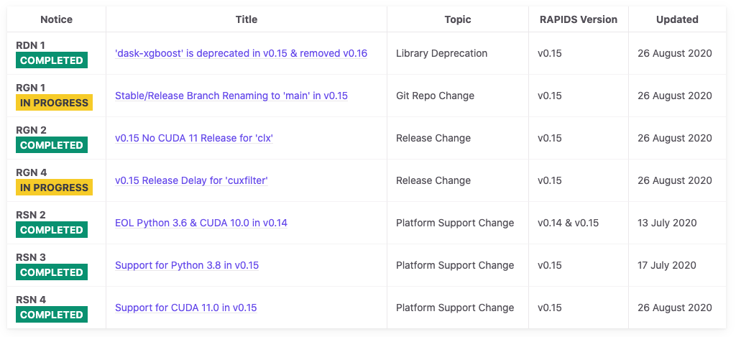
RAPIDS Notices
Communicate and document changes to RAPIDS for contributors, core developers, users, and the community
https://docs.rapids.ai/notices

Slide 94
Getting Started

Slide 95
5 Steps to Getting Started with RAPIDS
Install RAPIDS on using Docker, Conda, or Colab.
Explore our walk through videos, blog content, our github, the tutorial notebooks, and our example workflows.
Build your own data science workflows.
Join our community conversations on Slack, Google, and Twitter.
Contribute back. Don't forget to ask and answer questions on Stack Overflow.

Slide 96
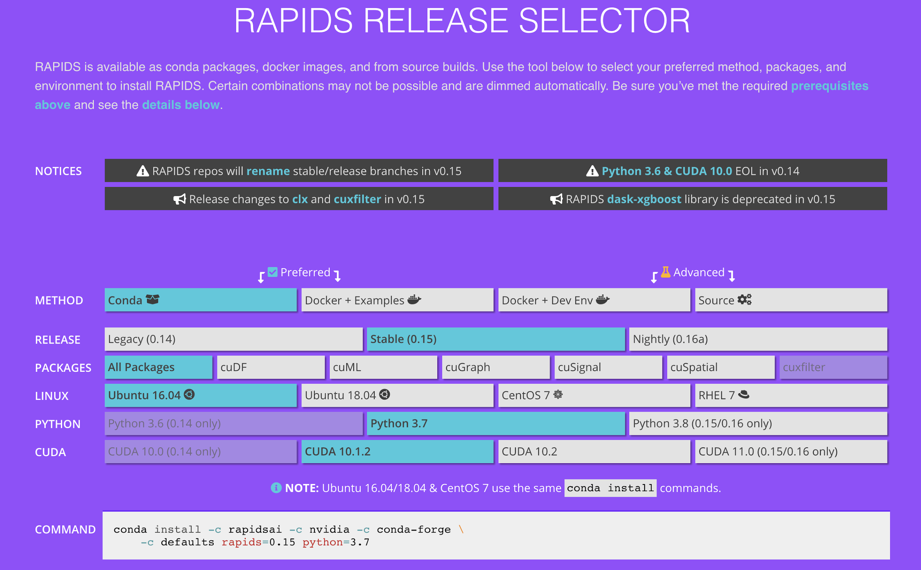
Easy Installation
Interactive Installation Guide
https://rapids.ai/start.html

Slide 97
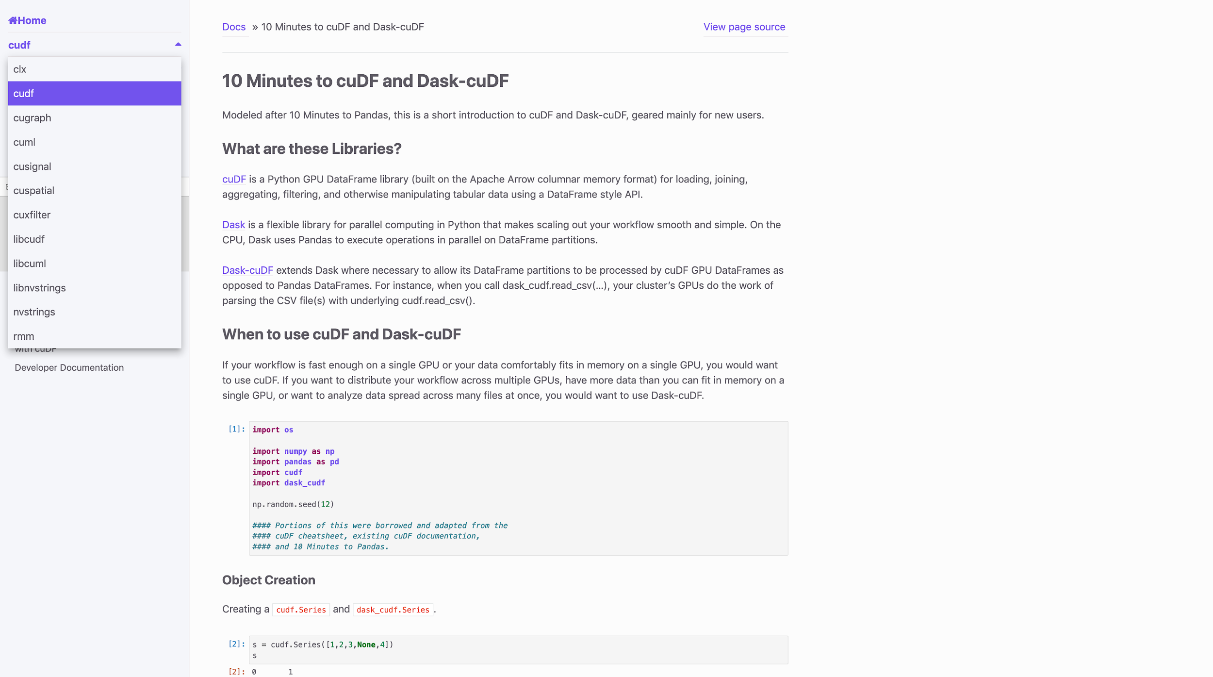

RAPIDS Docs
Up to Date and Easy to Use
https://docs.rapids.ai

Slide 98
RAPIDS Docs
Easier than Ever to Get Started with cuDF
https://docs.rapids.ai

Slide 99


Explore: RAPIDS Code and Blogs
Check out our Code and How We Use It
https://github.com/rapidsai
https://medium.com/rapids-ai

Slide 100

Explore: RAPIDS Github
https://github.com/rapidsai

Slide 101


Explore: Notebooks Contrib
Notebooks Contrib Repo has tutorials and examples, and various E2E demos. RAPIDS Youtube channel has explanations, code walkthroughs and use cases.

Slide 102




RAPIDS
How Do I Get the Software?
GITHUB
ANACONDA
NGC
DOCKER
https://github.com/rapidsai
https://anaconda.org/rapidsai/
https://ngc.nvidia.com/registry/nvidia-rapidsai-rapidsai
https://hub.docker.com/r/rapidsai/rapidsai/

Slide 103








Deploy RAPIDS Everywhere
Focused on Robust Functionality, Deployment, and User Experience
Azure Machine Learning
Cloud Dataproc
Integration with major cloud providers | Both containers and cloud specific machine instances Support for Enterprise and HPC Orchestration Layers

Slide 104

Join the Movement
Everyone Can Help!
GPU OPEN ANALYTICS INITIATIVE
APACHE ARROW
RAPIDS
DASK
https://arrow.apache.org/
https://rapids.ai
https://dask.org
http://gpuopenanalytics.com/
@ApacheArrow
@RAPIDSAI
@Dask_dev
@GPUOAI
Integrations, feedback, documentation support, pull requests, new issues, or code donations welcomed!

Slide 105

THANK YOU
Joshua Patterson
joshuap@nvidia.com
@datametrician
Notes:
https://rapids.ai/ https://github.com/rapidsai
https://docs.rapids.ai/overview

